Slide 1
Tis the Season for BEE-cisions
– May 2017 –
Micky Cross
Co-First Vice President

Slide 2
Beginning Observations
Challenge: Make Precise Decisions in an Imprecise World
Beekeeping Adage – No One Right Answer (i.e. “Ask 10 beekeepers …)
Mark Dykes (Chief Apiary Inspector – Texas Apiary Inspection Service)
“There Usually Is One Right Answer,
We Just Don’t Have Enough Data To Know What It Is”
Data, Decisions, Alternatives
Can’t Cover All Possibilities
Beekeeper Experience and Judgement Critical – Collaborate! Use Mentors
Hopefully Can Provide A Structured Approach To Help
Flow Chart Method
Doing Nothing Is Always An Option – Often The Best

Slide 3
Some Definitions
Split – Divide one hive into two hives
Increase – Take 4 or 5 frames from one hive and put into new full size brood box with remaining frames of drawn comb or new foundation
“Nuc” – Take 4 or 5 frames from one hive and put into “Nuc” box

Slide 4
Hive Resources - One 10-Frame Brood Box -
Queen, Young Nurse Bees, Older Nurse Bees, Foraging Bees, Brood, Pollen, Honey
Old Nurse Bees (Wax and Guard) + Foragers
Young Nurse Bees
(Clean & Feed)
Old Nurse Bees (Wax and Guard) + Foragers
1
2
3
4
5
6
7
8
9
10
Honey/Pollen/Brood
Honey/Pollen
Honey

Slide 5
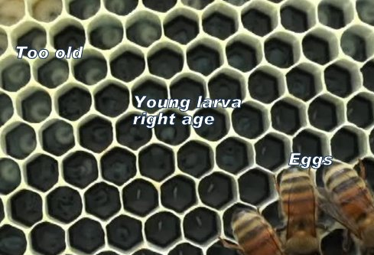
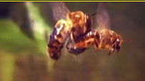
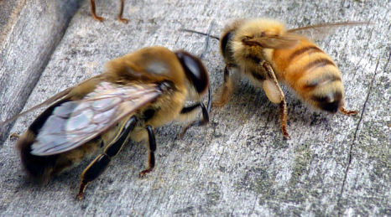
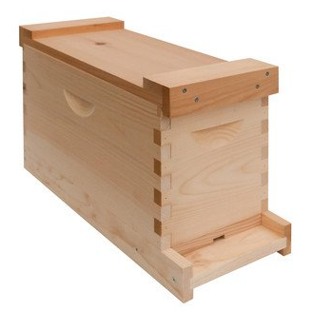
Resources
Brood Frames Fall Into Two Important Categories
Open Brood With Eggs and/or 1 Day Old Larvae (Egg Frames)
Open Brood With Older Larvae and Capped Brood (Brood Frames)
Don’t Forget the Drones
Flying Drones Critical to Creating New Mated Queens
And, Don’t Forget The Wooden Ware
You Have To Have The Equipment To Do The Action

Slide 6
Resource Summary
Bees
Queen
Young Nurse Bees
Old Nurse Bees
Foraging Bees
Flying Drones
Frames In Your Hives
Open Brood With Eggs and/or 1 Day Larvae (Some Honey & Pollen)
Brood (Older Larvae and Capped) (Some Honey & Pollen)
Honey/Pollen
Honey
Equipment (10 Frame, 8 Frame, “Nuc” Sizes)
Bottom Boards
Boxes
Lids
Feeders
Queen Excluders
Entrance Reducers
Queen Cell Cups

Slide 7
Hive “Type”
Has The Hive Over-Wintered?
Existing Hive
Yes
No
New Hive
Produce Honey or Bees?
Honey
Goal Is To Grow Into Strong Hive
Honey Hive
Bees
Goal Is To Maximize Honey Production
Brood Hive
Goal Is To Make Splits, Increases, or “Nucs”
Queen Rearing, Brood Frames, Drawn Frames, Etc.
Beyond Today’s Scope

Slide 8
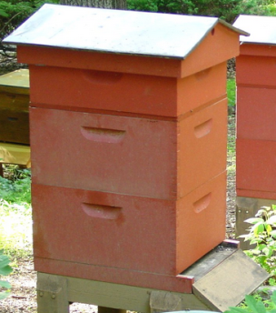
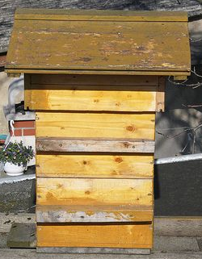
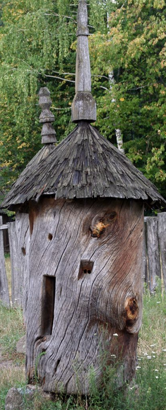
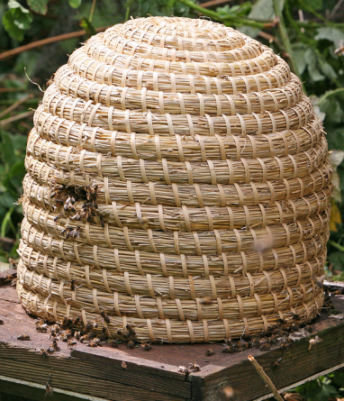
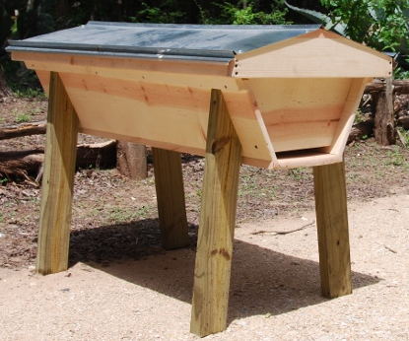
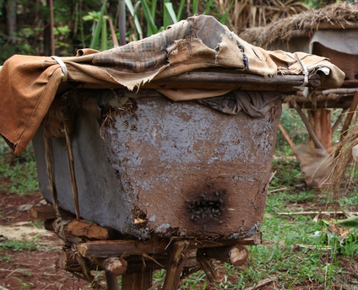
Hive Types
Three Types
New
Honey – Produce Honey
Brood – Produce Bees
Initial Designation – Can Always Change
One Additional – “Swarm” Hive
Presence of Queen Cells

Slide 9
New Hives
Swarm Cells?
Utilizing two Outermost Frames?
Should They Be?
Swarm Hive
Yes
Yes
No
No
Do Nothing
No
Yes
Double Deep?
Evidence of Queen?
Remove Box/Super if Present
No
Possible Weak Hive
Add Deep
Create Queen
Add Queen
Combine
Yes
No
Recourses To Make Queen?
Yes
Yes
Add Honey Super
No
Strong Brood Pattern?
No
Add Queen
Combine
Yes
Do Nothing

Slide 10
‘Honey” Hives
Swarm Cells?
Utilizing two Outermost Frames?
Should They Be?
Swarm Hive
Yes
Yes
No
No
Do Nothing
No
Yes
Remove Box/Super if Present
No
Double Deep?
Evidence of Queen?
Add Deep
Possible Weak Hive
Yes
Add Queen
Create Queen
Combine
Yes
No
Recourses To Make Queen?
No
Has Honey Super?
Yes
Add Honey Super
Strong Brood Pattern?
No
Yes
No
Add Additional Super
Yes
Add Queen
Combine
Do Nothing
Celebrate!

Slide 11
‘Brood” Hives
Swarm Cells?
Utilizing two Outermost Frames?
Should They Be?
Swarm Hive
Yes
Yes
No
No
Do Nothing
No
Yes
Double Deep?
Evidence of Queen?
Remove Box/Super if Present
No
Possible Weak Hive
Add Deep
Contribute Frames to Other Hives
Use As ‘Honey” Hive?
Add Super
Yes
Create Queen
Add Queen
Combine
Yes
No
Recourses To Make Queen?
Has Resources For Two Hives?
No
Strong Brood Pattern?
Yes
No
Yes
No
Next Slide
Yes
Add Queen
Combine
Do Nothing

Slide 12
‘Brood” Hives (Continued)
Contribute Frames to Other Hives
Use As ‘Honey” Hive?
Add Super
No
Has Resources For Two Hives?
Celebrate!
Yes
Walk Away Split
Increase (create queen)
Nuc (create queen)
Multiple Nucs (create Queens)
Split With New Queen
Increase With New Queen
Nuc With New Queen
Multiple Nucs With New Queens
Contribute Frames To Other Hives
Increase With New Queen
Split With New Queen
Nuc With New Queen
Multiple Nucs With New Queens
No
Has Resources To Create Queen?
Yes

Slide 13
‘Swarm” Hives - Swarm Cells Already Formed -
Walk Away Split
Increase
Nuc
Harvest Queen Cells
Cull Queen Cells
Split
Harvest Queen Cells
Cull Queen Cells
Double Deep?
No
Yes
Chance For Free Queens or Hive
Hope!
Doing Nothing Is Not An Option

Slide 14
Actions - Beekeeper Knowledge List -
Do Nothing
Add A Second Brood Box (Pyramid)
Add Honey Super
Add Second Honey Super (Checkerboard)
Add Purchased Queen: Eliminate Old Queen (if present) & Introduce New Queen
Hive, Split, Increase, Nuc, Multiple Nucs
Add Ripe Queen Cell: Eliminate Old Queen (if present) & Introduce New Queen
Hive, Split, Increase, Nuc, Multiple Nucs
Create Queen: Add/Ensure Frames of Open Brood With Eggs and/or 1 Day Larvae
Hive, Split, Increase, Nuc, Multiple Nucs
Remove Super
Remove Brood Box
Contribute Frames To Other Hives
Combine: Eliminate The Hive In Question By Using Frames In Other Hives
Normally Will Not Use The Queen, If There Is One
Harvest Queen Cells
Cull Queen Cells
Hope

Slide 15
Resource Requirements
Do Nothing
Conviction & Patience
Add a Second Brood Box (Pyramid)
Empty Box & Frames (Usually a Deep, Could Be a Medium)
Add a Honey Super (Or Additional Super - Checkerboard)
Empty Box & Frames (Usually a Medium, Could Be a Deep or Shallow)
Add Queen
Queen (Mated/Caged, Ripe Queen Cell)
Young Nurse Bees (Essential) & Old Nurse Bees
Frames of Brood, Pollen/Honey, Honey
Create A Queen
Frame(s) of Open Brood With Eggs and/or One Day Old Larvae (Essential)
Young Nurse Bees (Essential) & Old Nurse Bees
Frames of Brood, Pollen/Honey, Honey
Flying Drones
Combine or Contribute
Multiple Hives
Remove Box/Super
Proper Distribution/Storage of Frames
Hope
Hey, You’re a Beekeeper – You Already Got This

Slide 16
Summary
Hive Type | Situation | Options
New | Congested | Add Deep
 |  | Add Super
 | Nominal | Do Nothing
 | Weak | Do Nothing
 |  | Combine
 |  | Add Queen
 |  | Create Queen
Hive Type | Situation | Options
Honey | Congested | Add Deep
 |  | Add Super
 |  | Add Second Super
 |  | Contribute
 | Nominal | Do Nothing
 | Weak | Do Nothing
 |  | Combine
 |  | Add Queen
 |  | Create Queen
Hive Type | Situation | Options
Brood | Congested | Add Deep
 |  | Split
 |  | Increase
 |  | Nuc
 |  | Contribute
 | Nominal | Do Nothing
 | Weak | Do Nothing
 |  | Combine
 |  | Add Queen
 |  | Create Queen
Hive Type | Options
Swarm | Split | Increase | Nuc | Harvest | Cull

Slide 17
QUESTIONS

