Slide 1
Frame Storage
James & Chari Elam
BluebonnetBeekeeping.com
2017

Slide 2
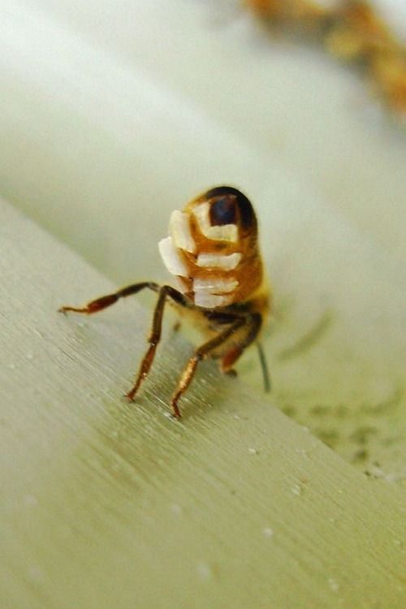
What is the cost of drawn comb?
It takes
Roughly 1.6 lbs. of honey/syrup to produce 1 frame of drawn comb
Randy Oliver – Study 2016
6 – 8 pounds of honey consumed by a
Honey Bee to produce
1 pound of wax

Slide 3
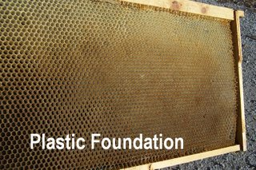
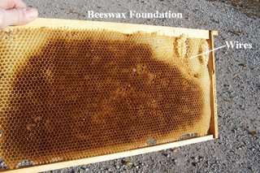
During the peak of a nectar flow it takes a colony 7 days to draw 2 deep frames of comb…
Worth taking care of?

Slide 4
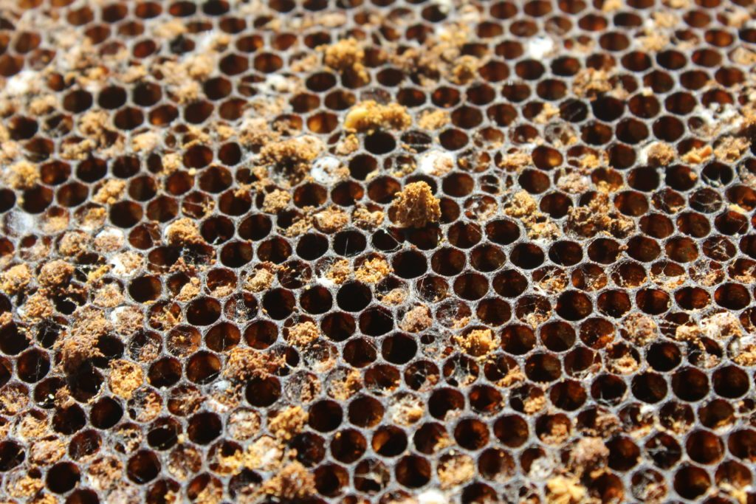
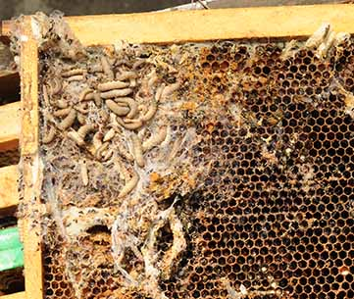
What are we “protecting” them from?
Wax Moths

Slide 5
Basically 2 Methods
Open air ventilation
Sealed using Para Moth

Slide 6
Regardless of the method you choose
These 2 Steps will begin your method
Let the bees clean out the honey/nectar so that the frame is DRY so it won’t mold or attract Hive Beetles
Freeze the frame to kill any larvae

Slide 7
If you have very much pollen in your stored comb it will attract Hive Beetles!

Slide 8
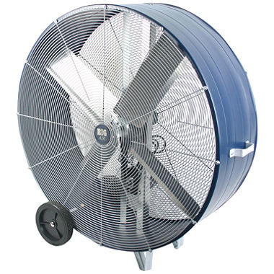
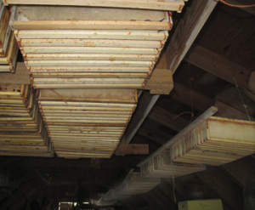
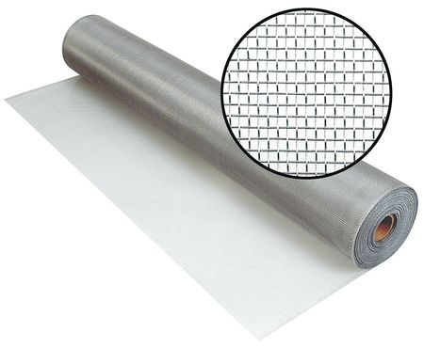
Open Air Storage
These are hanging from rafters in a barn – Not recommended for humid environments unless you can utilize a fan for the duration of the storage
Screen a bottom base/board with window screen wire. Stack boxes 4-5 high - top with a screened top. The light and cross ventilation is the formula here.

Slide 9
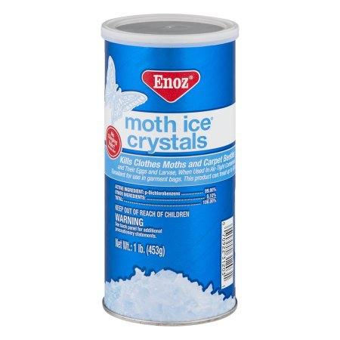
“Para-Moth”
crystals
(paradich-lorobenzene) or
(P-dichlorobenzen)
ONLY
Moth Balls containing “Naphthalene”
is harmful to bees.

Slide 10
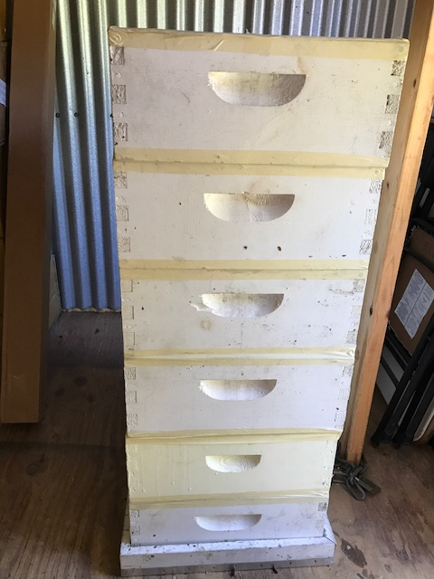
Place Telescopic lid upside down
Stack 2 boxes w/frames in it
Lay an piece of paper (8x11) in the center of the second box
Pour 2-3 Teaspoons Para-Moth on it
Add 2 more boxes
Repeat steps 3 & 4
Continue until you reach 6 boxes
Adding your final paper/Para-Moth
Top with a piece of cardboard cut to the size of the box
Tape each joint very well (except the bottom where the box and lid join)
Re-apply Para-Moth as needed

Slide 11
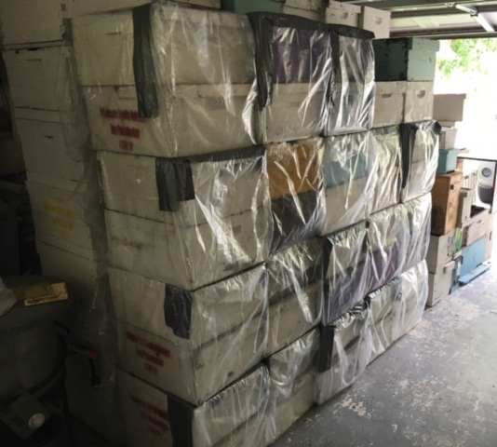
Para-Moth in bags
Place Para-Moth on paper “on top” of 2 boxes with frames
Wrap in “clear” plastic bags.
Tape securely
Idea of clear:
You are able to visually see any infestation if it were to occur

Slide 12
When using Para-Moth to store frames – you MUST
“air out” the boxes and frames for a week or two prior to installing on your hives in the spring
Older brood comb is more “attractive” to Wax Moths than newer white comb

Slide 13
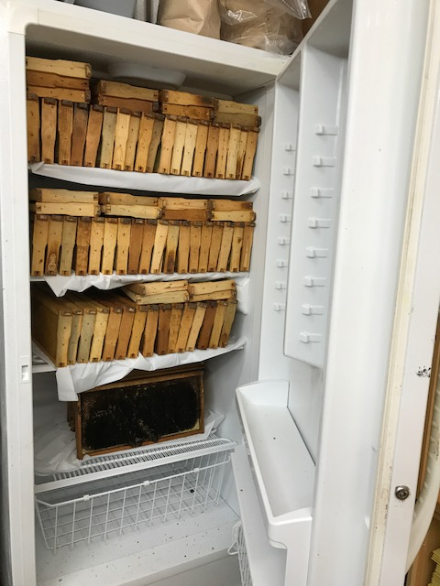
Easiest storage method…
Storing your drawn comb
frames in a freezer when
not in use
Take them out 24 hours ahead of reinstalling them on the colony

Slide 14
Regardless of the method you choose…
Protect your investment!
It can make the difference in how successful you are in beekeeping!
James and Chari Elam
BluebonnetBeekeeping.com
2017

