Slide 1
Hive Inspections
MoCo Beekeepers Association Meeting
April 2019
By Wayne Owen

Slide 2
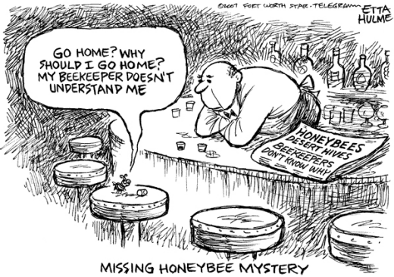
“A Bee Walks into a Bar…”
2
Notes:
Source: Ft Worth Star Telegram

Slide 3
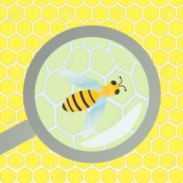
Why Do Hive Inspections?
Assess health and strength of colony in general
Gather data to make informed decisions such as:
Feed or not
Add brood box or honey super
Treat for pests or pathogens
Split or combine
Investigate abnormal activity or observations
Follow up after making a major “beekeeper move” such as:
Introduced new queen
Installed a nuc or package
Split/combined a colony
3

Slide 4
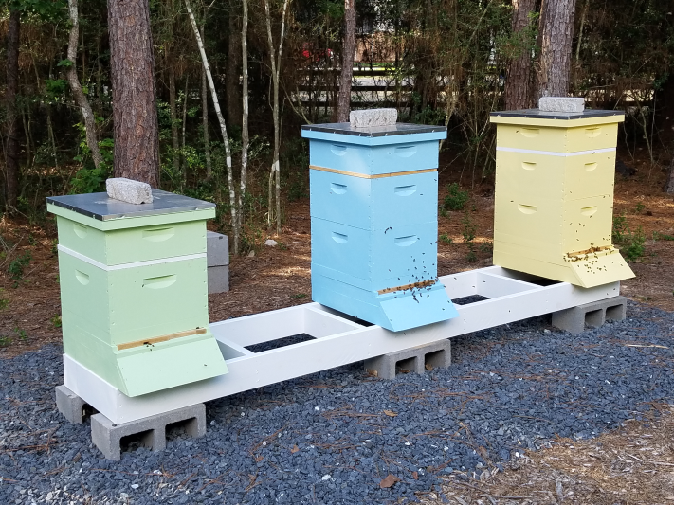
Types and Frequency of Hive Inspections
“Deep Dive” – extensive inspection 3-4 times per year
“Lift and Look” – light inspection as needed or dictated by situation (new package or nuc)
Generally avoid disrupting hive during nectar flow
Keep time in colony to a minimum (15 minutes) or just as long as it takes to get the task done
4

Slide 5
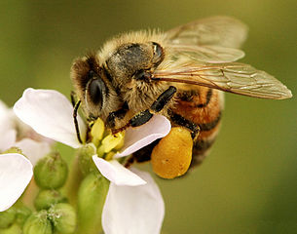
Best Time of Day to Inspect Hives
As a general rule:
Warm day – above 55 degrees F
Late enough for foragers to be out
Sunny and clear
Little or no wind
No rain
Not at night
However, circumstances may dictate timing and might be less than ideal.
5

Slide 6
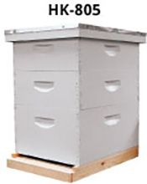
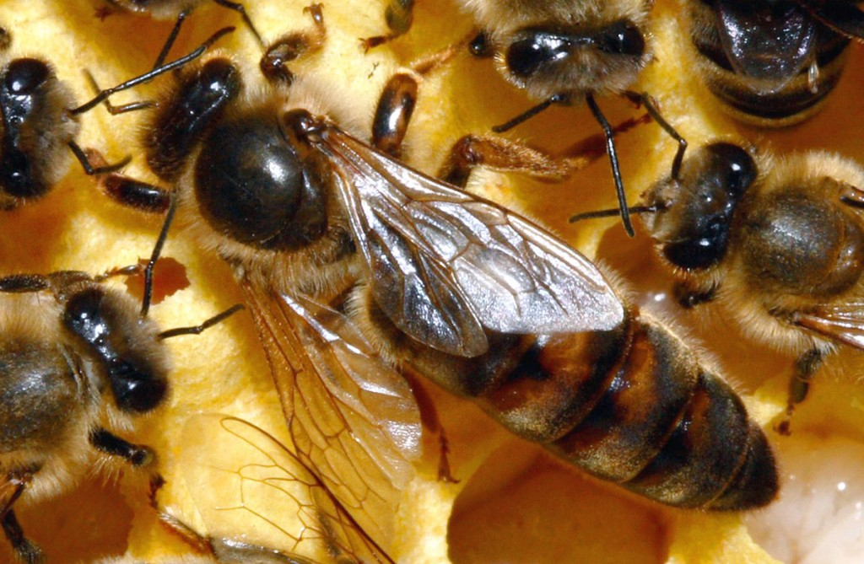
Have a Purpose for Each Inspection
Always have a reason to go into your hives
Be as specific as possible
“Plan your work and work your plan.”
Helps to write it down
But be flexible to deal with the unexpected
6

Slide 7
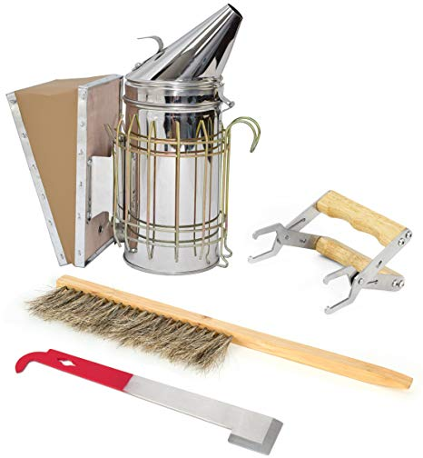
Gather Your Tools and Supplies
Bee suit/jacket, hood/veil, & gloves
Smoker and fuel
Tools – hive tool, bee brush, frame gripper, etc.
SHB – traps, oil, DE, etc.
Record keeping – checklist, phone, etc.
Other equipment/supplies you anticipate needing (woodenware, extra frames, medication, etc.)
7

Slide 8
Before You Open the Hive
Observe activity/traffic at the entrance – low traffic indicates a problem
Good sign when bees are bringing in pollen
Look at the ground underneath and around hive – bees crawling on the ground may be a problem
Examine the outside of the hive
Get a sense of what “normal” looks like in your apiary for the time of year and compare that to what’s going on now
Entrance Traffic | Number of Bees
High | 1 or more bees per second
Medium | 1 bee every 4 or 5 seconds
Low | 1 bee every 10+ seconds
8

Slide 9
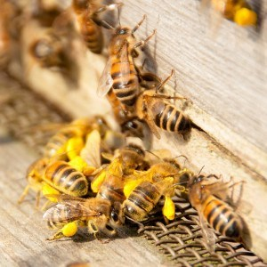
Practice Good Inspection Techniques
Approach and work hives from back or side
Avoid quick body movements or jarring the frames
Puff some smoke into the entrance and pause a few seconds
Take off outer cover and puff smoke into hole in inner cover
Use the outer cover to stack hive boxes as you remove them
Pry off the inner cover and puff smoke underneath
Prop the inner cover at the side of the hive
Do not block entrance generally
Move deliberately but not so quickly that you do damage
Avoid dropping frames and boxes
Use smoke judiciously (just enough)
9

Slide 10
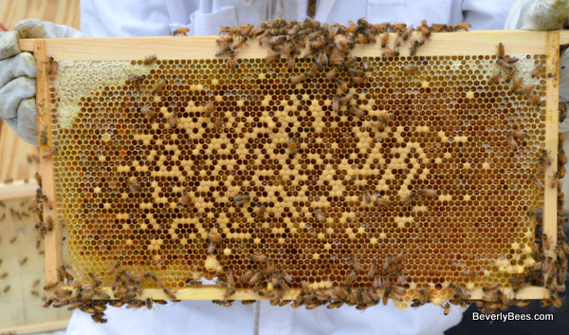
When Working Inside the Hive
Use the hive tool to un-stick a frame or two and remove from hive (usually end frame) – prop against the hive or place on stand
Pull out frames vertically and slowly
Examine frames over the hive
Usually return frames to their original position (place and orientation)
Scrape excess burr comb or propolis from the tops of frames – or anywhere it shouldn’t be
Try not to squish too many bees (estimated we kill an average of 150 bees each hive inspection)
10
Notes:
150 bee kill source: The Beekeeper’s Handbook, 4th Edition, Sammataro and Avitabile, Chp 5, p. 61

Slide 11
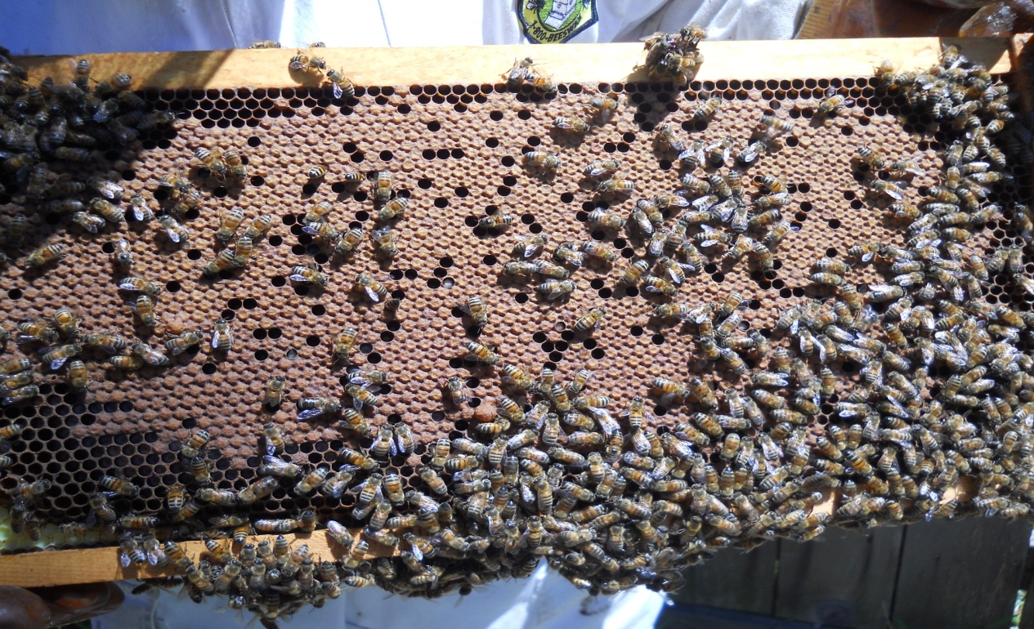
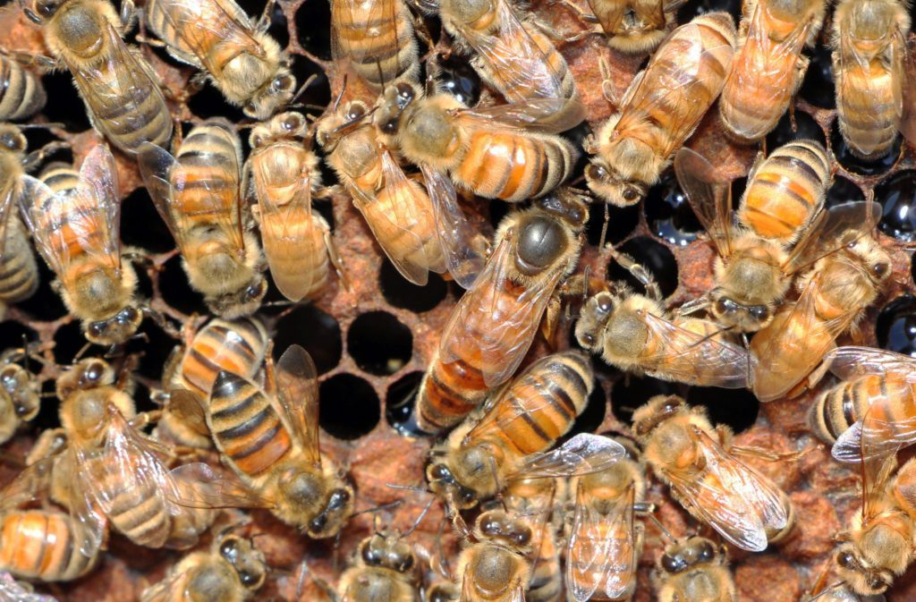
What You Usually Look for Inside
The Colony
Queen right – don’t actually have to see her to know
Adult bee strength and health – number, evidence of pests and diseases, etc.
Brood – amount, stages, pattern
Ideal ratio of eggs:open:capped is 1:2:4
Temperament
Swarm potential
The Pantry & Living Conditions
Resources– nectar, honey, pollen
Space for queen to lay
Space for colony to live and work
11
Notes:
1:2:4 ratio: The Beekeeper’s Handbook, 4th Edition, Sammataro and Avitabile, Chp 5, p. 67

Slide 12
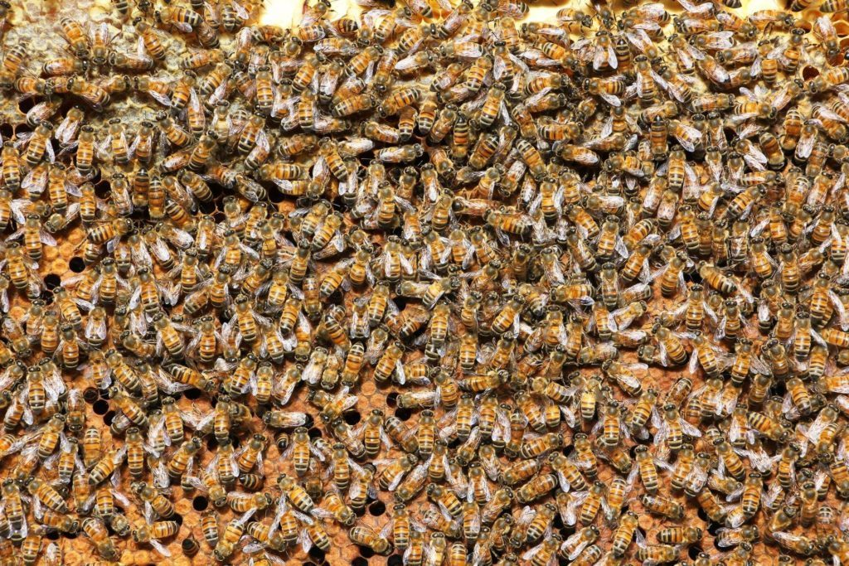
Simple Guide to Colony Strength by Month
Month | Frames of Bees
January | 5+
March | 8+
May | 14+
November | 12+
12

Slide 13
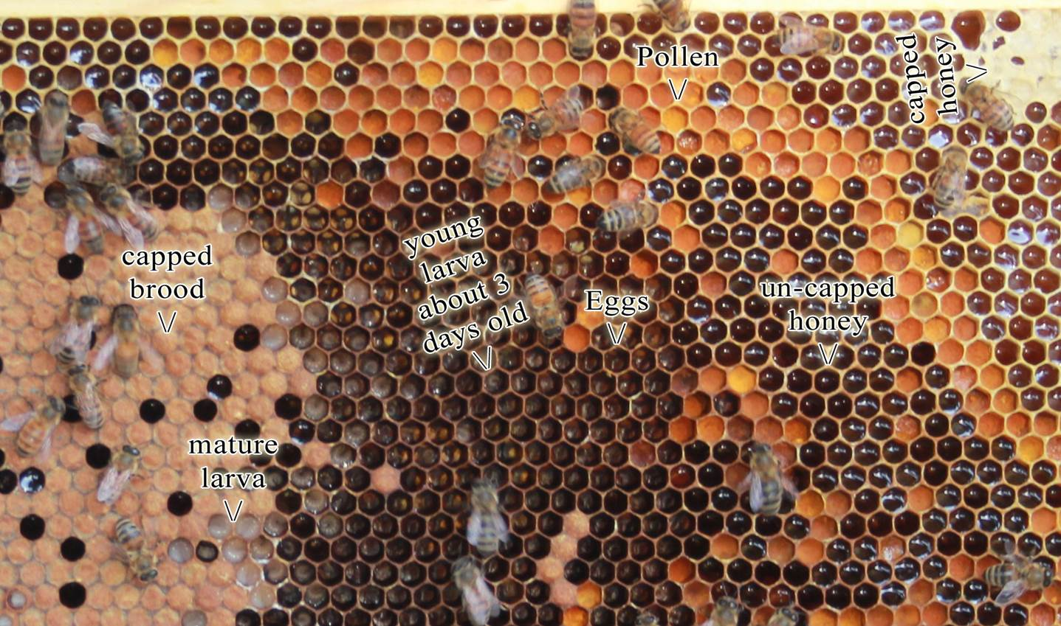
Learn to “Read” a Frame
13

Slide 14
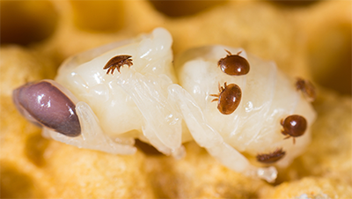
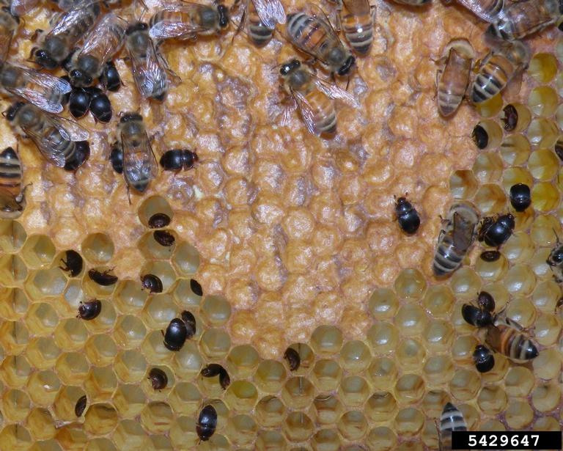
Look for Signs of Pathogens or Pests
Pathogens
American Foul Brood
European Foul Brood
Nosema apis
Sacbrood
Chalkbrood
Deformed Wing Virus
Pests
Small Hive Beatles
Varroa Destructor
Wax Moths
Other?
14

Slide 15
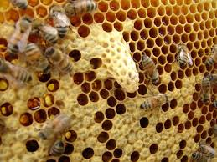
Look for Signs of Supercedure or Emergency
Bees will build supercedure cells to replace an old or failing queen
Bees will build queen cells in an emergency
Supercedure and emergency cells are usually located on the face of comb
15

Slide 16
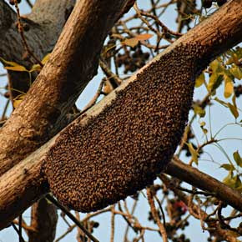
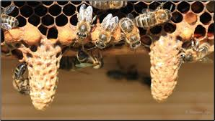
Look for Signs of Swarm Threat
Crowded conditions in the hive
Honey bound frames – little or no room for queen to lay
Swarm cells - usually built near the bottom of comb
16

Slide 17
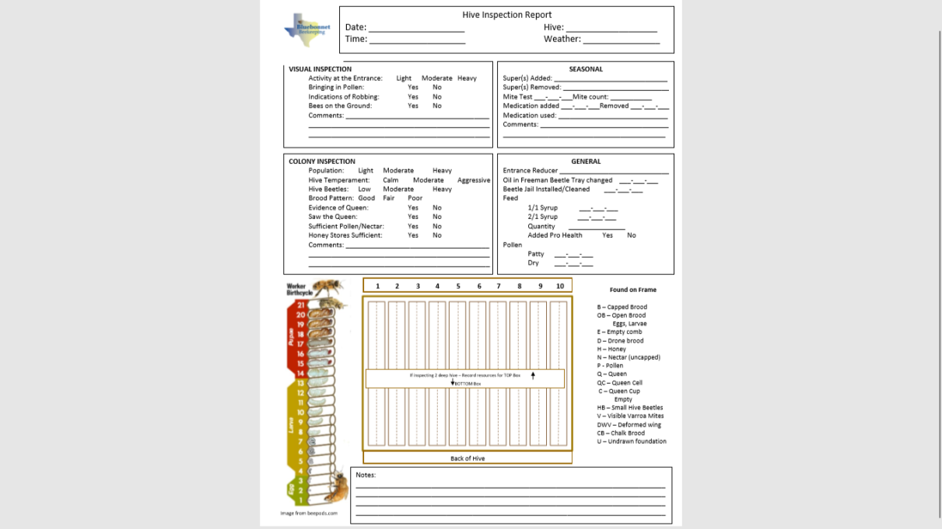
Take Notes and Keep Good Records
May help to name or number hives
Taking notes helps you remember and to make sense of the inspection
Provides direction for next hive re-entry
Checklists are helpful and when filled out, can be a good source of documentation
System could be as simple as placing bricks on hive in a certain way
At least write on outer cover
17

Slide 18
Questions?
18

Slide 19
Sources
Got Bees?, 1st Year Beekeeper Study 2017, Bluebonnet Beekeeping
Previous MoCo Bee Association presentations on similar and related topics by Chari and James Elam, Micky Cross, Dennis Cox, & others
TBA Summer Clinics
The Beekeeper’s Handbook, 4th Edition, Sammataro and Avitabile, Chp 5
19

