Slide 1
Oxalic Acid
in
Varroa Management
By Phyllis Martin
A significant amount of this
material was liberated from
Randy Oliver and Marion Ellis

Slide 2
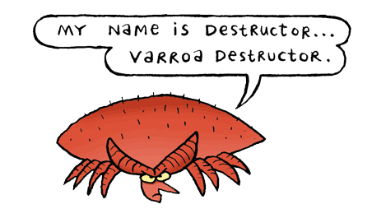
Notes:
Let’s talk about these little guys, and how to help our honeybees with their management of the impact from varroa.

Slide 3
Structure of Presentation
What is Varroa?
Varroa biology
Varroa Management
Detection methods
When to treat
How to apply oxalic acid
Safety considerations of oxalic acid
Notes:
~This past weekend I was camping with my sister, and I told her I needed to work on this presentation. She pretends interest in my hobby, so asked about what I was presenting. When I started on the topic of “treating Varroa with oxalic” she asked “What is varroa?” It reminded me that I should start at the beginning.
~Varroa biology. It is not enough to know how to mix up a solution and squirt it on the bees. There is some biology of varroa that you have to understand to effectively control it.
~We will briefly discuss detection methods and how you make the decision to treat, or not.
~We will talk about when to treat,
~How to apply oxalic acid, and
~Safety considerations,

Slide 4
What is Varroa?
Notes:
Know your enemy

Slide 5
Sun Tzu
If you know the enemy and you know yourself, you need not fear the result of a hundred battles. If you know yourself but not the enemy, for every victory gained you will also suffer a defeat. If you know neither the enemy nor yourself, you will succumb in every battle.
Notes:
The ancient Chinese warrior Sun Tzu taught his men to “know your enemy” before going into battle. For if you don’t know your enemy, you will succumb in every battle. Well, we are going to battle these varroa.

Slide 6
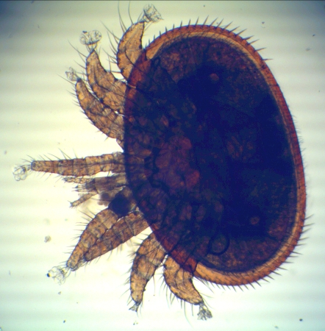
Varroa Destructor
1-1.8 mm long
1.5-2 mm wide
The Varroa mite is an external parasitic mite that attacks the honey bees Apis cerana and Apis mellifera. The disease caused by the mites is called varroosis.
Wikipedia
Notes:
So here is your enemy. The Varroa Destructor. Wikipedia tells us that the varroa destructor is a mite that is an external parasitic mite that attacks the honeybees Apsi cerana and Apis mellifera. The disease caused by the mites is called varroosis.
`This mite was first detected in the U.S. in 1987.
`It is an obligate parasite of the honeybee. This means that the varroa mite cannot complete its life-cycle without exploiting a suitable host. This particular parasite cannot live on wasps or yellow jackets, or even leafcutter bees or bumble bees. It can only live and reproduce on the Asian honeybee and the European honeybee.
`It feeds on both adult and brood bees.
`It is considered a major contributor to colony collapse disorder (CCD).
`At less than 2mm in diameter, it is still a relatively large parasite when compared to the size of its host.
Don’t underestimate this small little mite; in the honeybee industry, the varroa destructor is your………

Slide 7
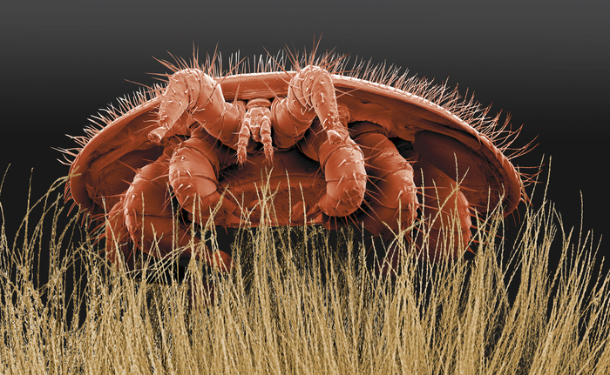
Notes:
~Public Enemy
~Number 1

Slide 8
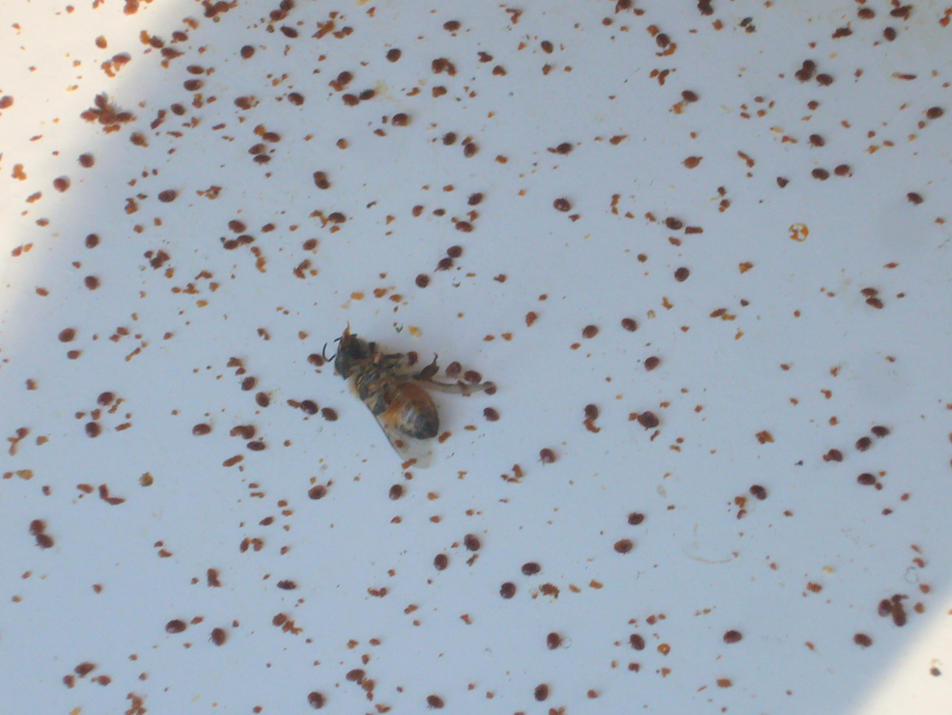
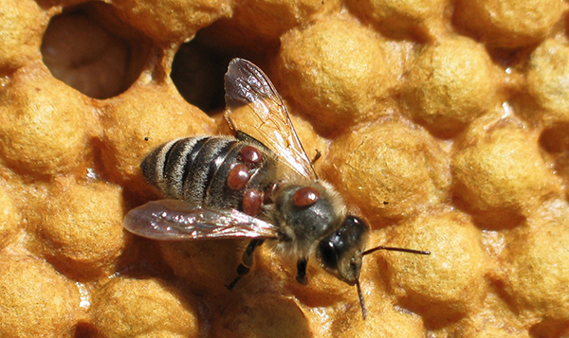
Notes:
~Any guess as to how many varroa are on this white board? A lot of this is was pieces of wax, so it may not be as many as it seems, but I counted 132 varroa on this sample.
~This is what varroa looks like on a bee. We can see 5 sucking the hemoglyph from this bee.
~Here is a close up of your nemesis. The varroa mite.

Slide 9
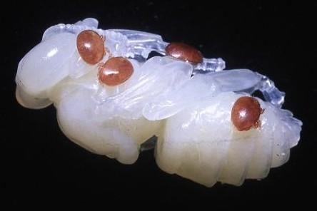
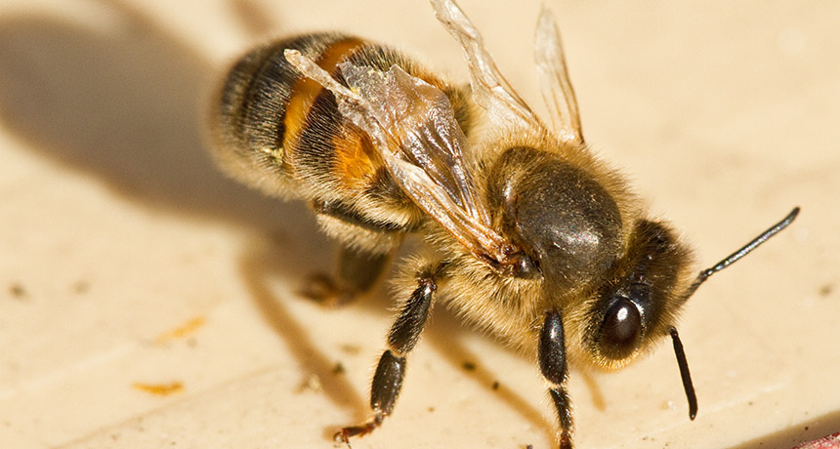
Notes:
~It is disheartening to see these relatively large parasites sucking the life out of honeybees, which we love so much. And this all begins even before the bees have a chance at life.
Managing varroa is particularly difficult because of the similarities between the host and the parasite. You are not trying to kill a tick that is on a dog, which would be an arthropod on a mammal. You are trying to kill a bug, that is on a bug. What we must find are ways to suppress varroa without damaging the host. It is an especially difficult problem, that has demanded creative solutions to address it.
When the varroa population gets high enough, you will see deformed bees emerging that are not capable of contributing to colony life.
~Here is an example of a bee with deformed wings. Obviously, it can never forage or fully contribute.
It is not common to see varroa on the bees in your hive. Check out this bee with the deformed wings. I cannot see any mites on her, but I am confident there are some.

Slide 10
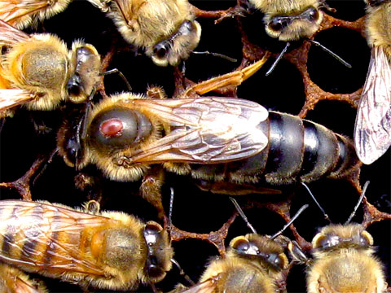
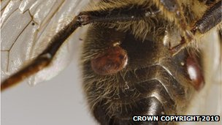
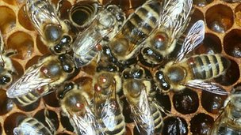
Notes:
~So here we have, not a marked queen, but a queen in a hive that desperately needs to be treated for varroa.
~And here, check out all of those mites on these bees. This hive has a severe varroa infestation. (8 arrows)
~But that’s where wax is supposed to come from! Unfortuantely, this is the most common place varroa are attached. Between the segments of the honeybee’s exoskeleton, on the bottom of the bee. You will rarely see varroa on your own bees. You are more likely to see bees with symptoms of varroa. They may have deformed wings, caused by a virus that is transmitted by varroa. Just looking at the adult bees will not be enough to help you determine if you have a varroa problem.

Slide 11
Varroa Biology
The Life Cycle of Varroa

Slide 12
Notes:
This is the most important information you can receive when learning about control of varroa. It will possibly be repeated. Multiple times.
Before the cell is capped, the varroa mite crawls down between the larva and cell wall and embeds itself in the brood food.
Once the cell is capped and the brood food is eaten the mite is liberated and begins to suck the hemolymph (bee blood) of the prepupa.
The mite lays its first egg (a male) 60 hours after capping and lays subsequent eggs (all female) at 30 hour intervals. Since drones take 24 days to maturity, while worker bees take 21, this leaves an additional 3 days for the mites to lay additional eggs.
Mating begins within the cell.
Adult female mites leave with the emerging honeybee, while the male mite and immature mites stay in the cell and die.

Slide 13
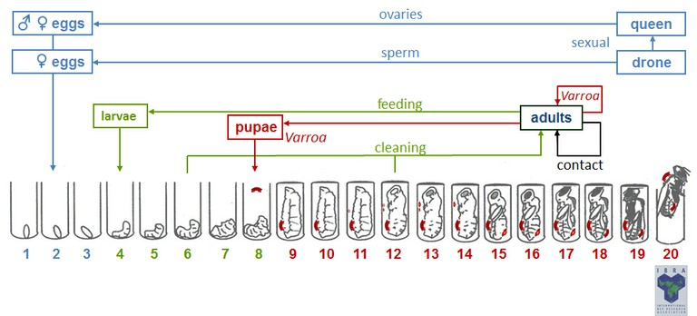
Understand the timing!
Notes:
Mites don’t enter a brood cell until about Day 8 after the egg is laid. Brood is sealed for 11-12 days. Work the math!

Slide 14
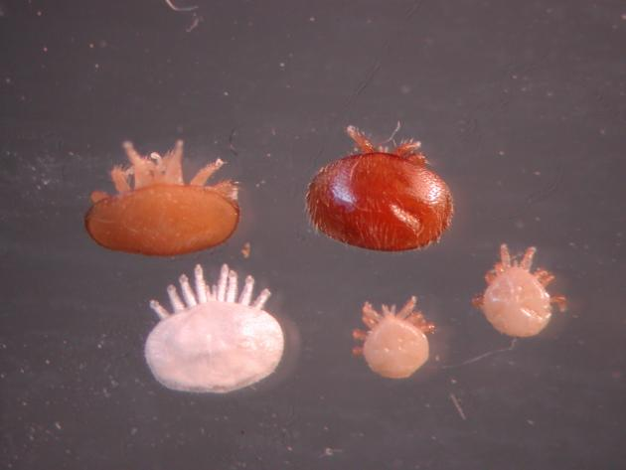
Notes:
So here is what the mites look like. From the top left, going clockwise, they are:
Mature daughter
Mother
Mature males (2)
Immature daughter
The female mites are the ones you are familiar with. They are large, and reddish-brown, and readily seen. A mentioned earlier, the males die in the cell.
Varroa is a prosperity disease. With a lot of the things you deal with like the foulbroods, you see colonies that go down over time, become weak, and maybe perish. Varroa builds up when the bees are the most prosperous. The bees are gathering nectar and pollen, and developing a lot of drone brood. That’s when the number of varroa in the colon zoom up. And you have a phenomena when the populations in the hive get high enough and they go off a cliff.

Slide 15
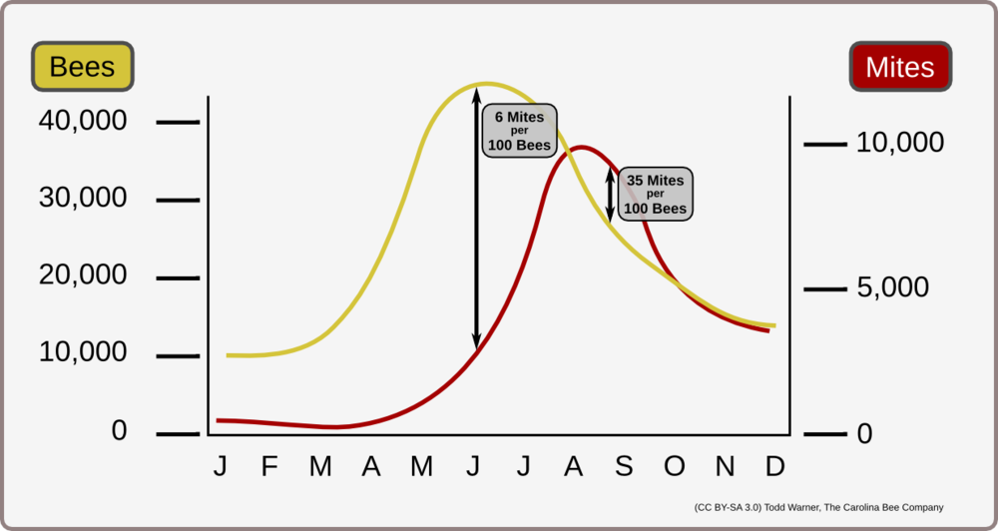
Notes:
I’m not going to go into much detail on this slide, because it has already been covered in other teachings. This chart provides a graphical demonstration of the prosperity aspect of a varroa infestation. When the colony starts to decline the number of live bees as part of winter preparation, the number of varroa mites to bee skyrocket. So you can have colonies that look great, with lots of honey and bees in June, but by mid-August, or September they are crashing. This is why you will have to monitor your colonies to know when your bees need help.

Slide 16
Varroa Management
How to detect and assess mite populations
How to know when mite populations suppression is needed
How to suppress mite populations with oxalic acid
Notes:
~To do that you need to know how to detect and assess mite populations.
~You need to know when mite population suppression is needed.
~You need to know how to suppress those mite populations if you find them.

Slide 17
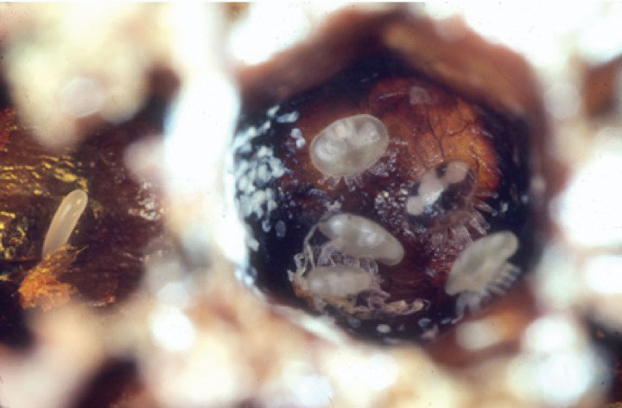
Detecting and Assessing Mite Populations
Dead Colony Method
Notes:
There are a number of ways to detect varroa. We will discuss two methods today. One is for dead colonies, and one is for live colonies. Dead colony assessment is best done by examining comb from the middle of the brood nest for varroa feces. Varroa enter the cell, and feed and defecate on the upper surface of the brood cell. So when you are looking at that surface, you want to hold the frame with the top bar toward you, and the bottom bar away from you. Light should be coming over your shoulder while you look down into the top of those cells. If you see the white, amorphous feces, that is a clear indication that this colony was severly affected by varroa. If there is a manageable amount of varroa, the bees can keep up with cleaning this. When the varroa are present until the point the bees perish, there is a lot left behind. So if you have a dead colony, and you wonder if it is varroa that took them out, this is a simple method of detection that can be performed in the bee yard.

Slide 18
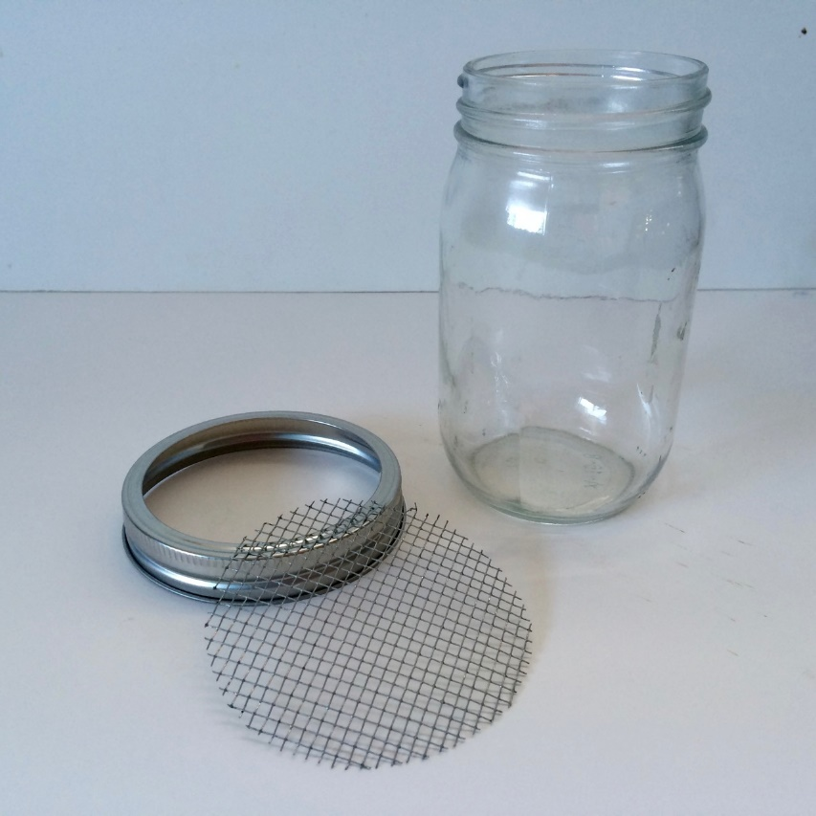
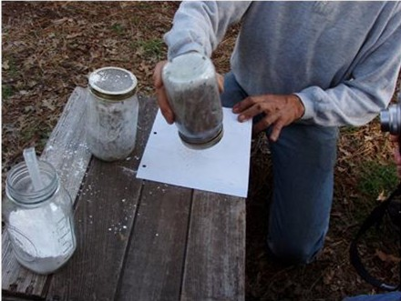
Detecting and Assessing Mite Populations
Live Colony Method
Notes:
The other method we will discuss today that can be used to assess live bee mite counts is called the powdered sugar roll.
~Nurse bees are placed in a jar (make sure the queen isn’t one of them), powdered sugar is sprinkled on them, the jar is rolled around, let it sit for a minute,
~then inverted the jar, and vigorously shake. I got to see Mary Reed demonstrate the vigor that should be used when shaking the bees. It is fairly intense. The shaking will dislodge the mites from the bees. The mites will lay on their backs, kick about, and suffer. This may help you to feel better as you help your bees through their mite struggle.
There are other methods of assessing mite counts, one of which involves an alcohol wash, which also dislodges the mites from the bees. Unfortunately, this method has a 100% kill rate for the tested bees. Because of this, you will have to learn of this method from someone other than me.
This can help you assess your mite population.

Slide 19
When to Treat
In the late winter, take action to reduce mite populations if they are detectable using the sugar roll technique.
Sample again in mid-September. If you detect 3 or more mites per 100 bees (9 mites on a 300 bee sample), remove crop and suppress mite populations.
If you detect less than 3 mites per 100 bees in mid-September you can delay suppression measures until colonies are “broodless.”
Notes:
The sugar roll method of testing for varroa will tell you if you need to treat now, or later. For all practical purposes, all of our bees have varroa, and when they get into the range of being a problem, beekeepers need to address it. However, you don’t want to treat unless it is necessary, because Varroa treatments create stress for bees.
~You want to reduce mite populations anytime they are detectable with the sugar roll technique in the spring. There will be quite a lengthy time period when honey supers are on the hives, and as we saw earlier, mid- to late-summer is when varroa populations outpace honeybee populations.
~You want to sample for varroa again in mid-September. Bees rarely die of varroa until mid-September until October or November. So if you sample again in mid-September, and detect 3 or more mites per 100 bees, which would be 9 mites from a 300 bee sample, you need to get the honey crop removed quickly, and suppress mite populations so the honeybees have an opportunity to rear healthy bees going into the winter.
~If you detect less than 3 mites per 100 bees in mid-September you can delay suppression methods until colonies are “broodless.” I put the word “broodless” in quotes because in this part of the country, we rarely go completely broodless. However, it is when we are brood-less.

Slide 20
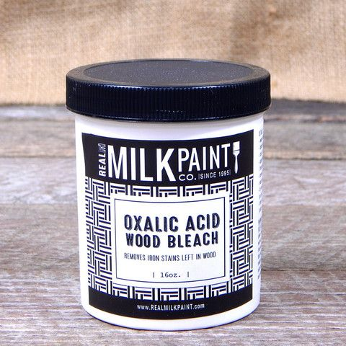
Suppressing Mite Populations
Why Oxalic Acid?
Approved in Europe for over 20 years
Used in Canada since 2010
Notes:
Used in Europe for over 20 years with no indication of resistance
Been used in Canada since 2010 with no indication of resistance
Why is the United States so late to the party?
Oxalic acid isn’t patented. It is wood bleach, and can be purchased in paint stores, or online for a VERY reasonable price. There was never a lobby to get its use approved in the United States. Despite this, approval for use in honeybee colonies was recently approved.

Slide 21
Acids are much more
toxic to mites than to bees
Notes:
Varroa is far more sensitive to acids than is the bee.

Slide 22
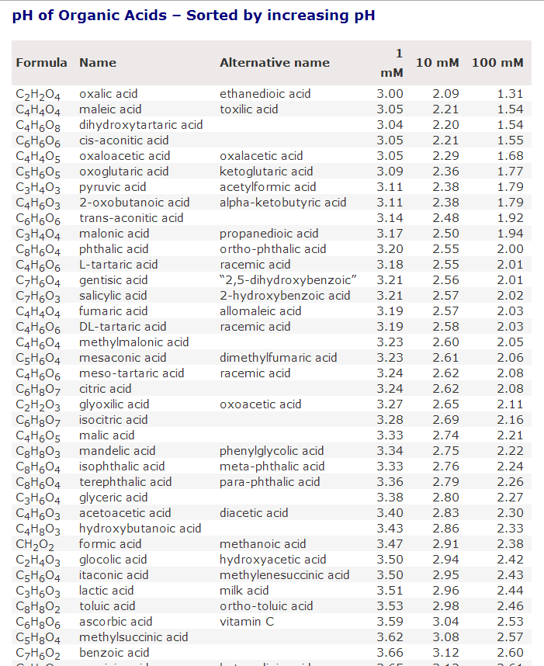
Oxalic is the strongest organic acid
Notes:
Oxalic has a high dissociation constant, meaning that it has more acidic effect than citric, acetic, or lactic acid—any of which can be used for varroa control. Oxalic just works best.

Slide 23
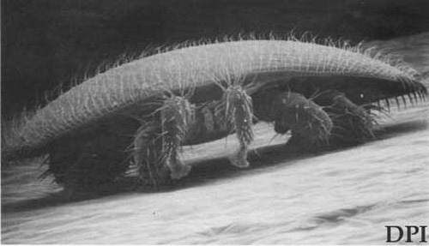
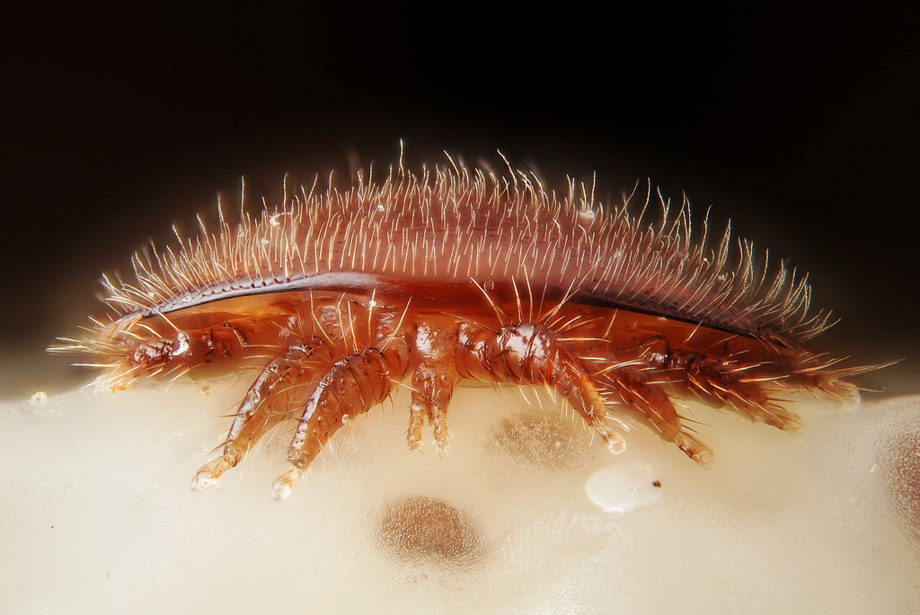
There are speculative hypotheses as to why acids kill varroa, but no definitive study.
Notes:
There is a theory that oxalic acid crystals are absorbed through varroa’s sticky tarsal pads.
I have also read a case study that found the acid dissolved the soft parts of the mites’ mouths.

Slide 24
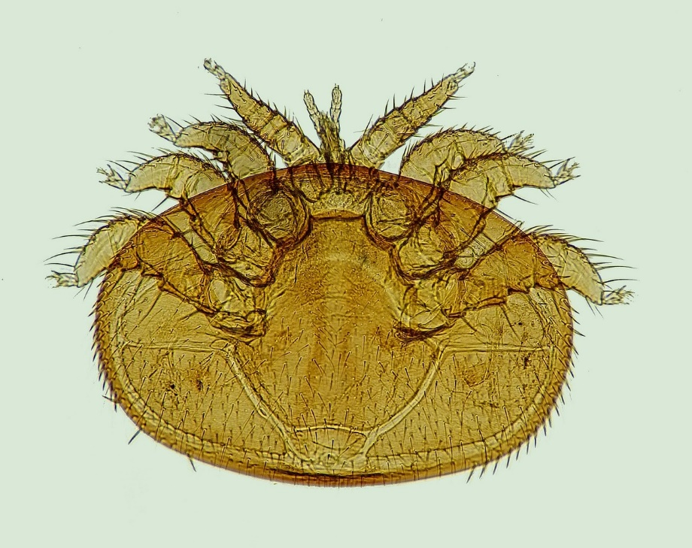
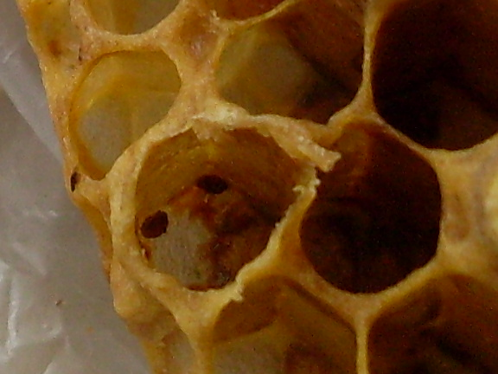
There are speculative hypotheses as to why acids kill varroa, but no definitive study.
Notes:
~Oxalic acid is a colorless and crystalline material
~It is soluble in water, which means there are no residues remaining in beeswax after use
~It has a low volatility
~Oxalic acid sublimates when heated to 315-372 F, which means it will go directly from solid to gas without passing through the liquid stage.

Slide 25
Safety to Humans

Slide 26
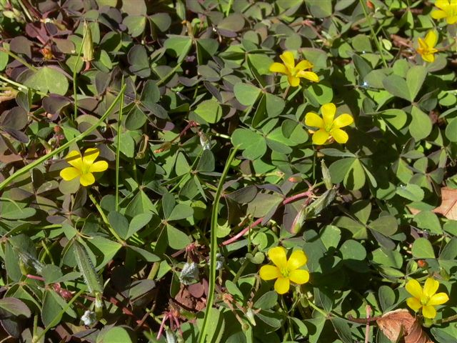
Oxalis
Notes:
This is a photo of one of the oxalis species. According to Randy Oliver, most Californians remember enjoying sucking on the stems of Buttercup Oxalis as kids. The juice tastes similar to lemonade, and is essentially the same as the oxalic syrup that we apply to our hives.

Slide 27
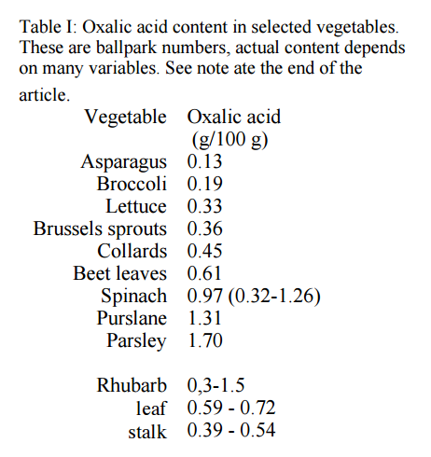
http://helios.hampshire.edu/~nlNS/mompdfs/oxalicacid.pdf
Notes:
Oxalic acid is found naturally in many plants and animals. It serves the role of being a defensive chemical in the plant world. Its taste helps plants repel certain feeders. We eat plenty of oxalic acid in vegetables in a healthy diet. Plants that we consume in our diet that have oxalic acid include rhubarb, broccoli, turnips, kale, radishes, even chocolate has oxalic acid in it.
Oxalic acid is also a predator repellent for some insects, like the box elder bug.

Slide 28
Tastes like strong lemonade
Notes:
So Randy Oliver is perhaps braver than I am. I understand that oxalic acid is found naturally in plants, and am even very comfortable using it on my bees. I don’t think I would taste it, though.

Slide 29
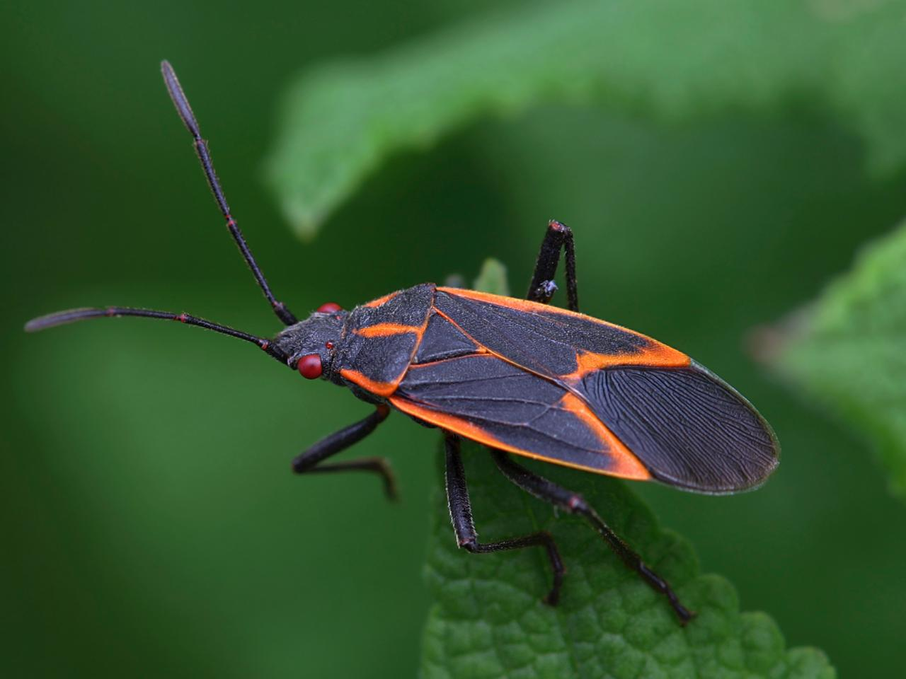
Notes:
This is a box elder bug. Have you ever seen a cat, or your dog, eat one of these? They spit it right out. I hear that’s because the box elder bug exudes large amounts of oxalic acid from between its leg joints. I could not verify this information, but also could not find out what this bug’s natural repellent is.

Slide 30
Notes:
In a nutshell,
Oxalic acid is something we consume on a daily basis.
It’s a natural constituent of honey
Many vegetables contain much more oxalic acid than honey does
There is a low risk of residues in honey
It is hydrophilic (readily dissolved in water) so you really won’t find residues in beeswax.

Slide 31
Purchasing Oxalic Acid

Slide 32
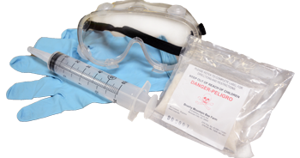
Notes:
Here is an image of a kit that can be purchased to utilize the dribble method of oxalic acid application. It includes goggles to protect your eyes, and gloves to protect your skin.

Slide 33
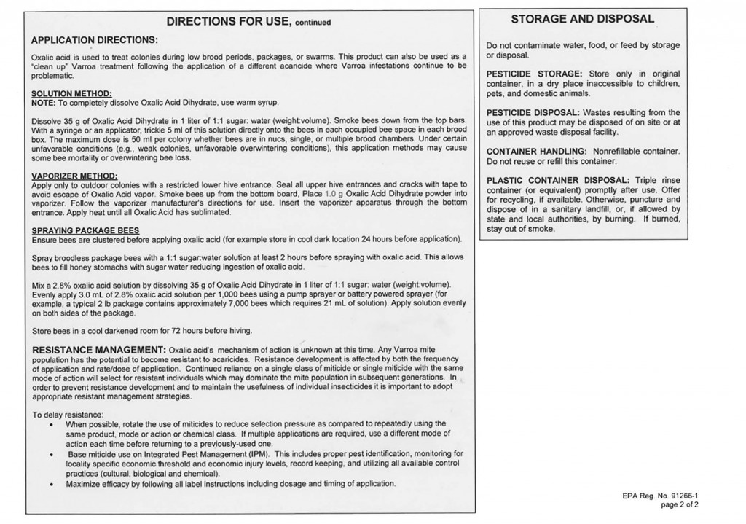
Notes:
This is the label that comes with oxalic acid when purchased for beekeeping husbandry. It is very well crafted. Sit down and read it. Follow it. There are some safety issues that you must be aware of. You can injure yourself with this material if you aren’t careful. Of course, this applies to many beekeeping items, such as an uncapping knife. Oxalic acid is perfectly safe to use, when you follow the directions.

Slide 34
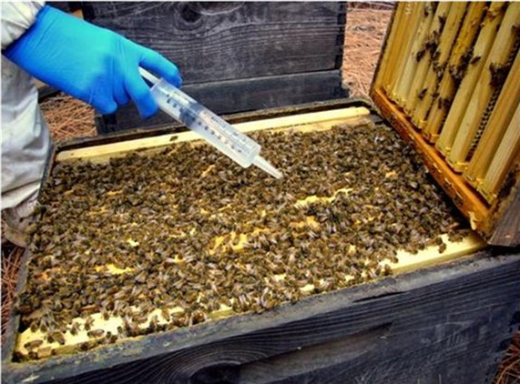
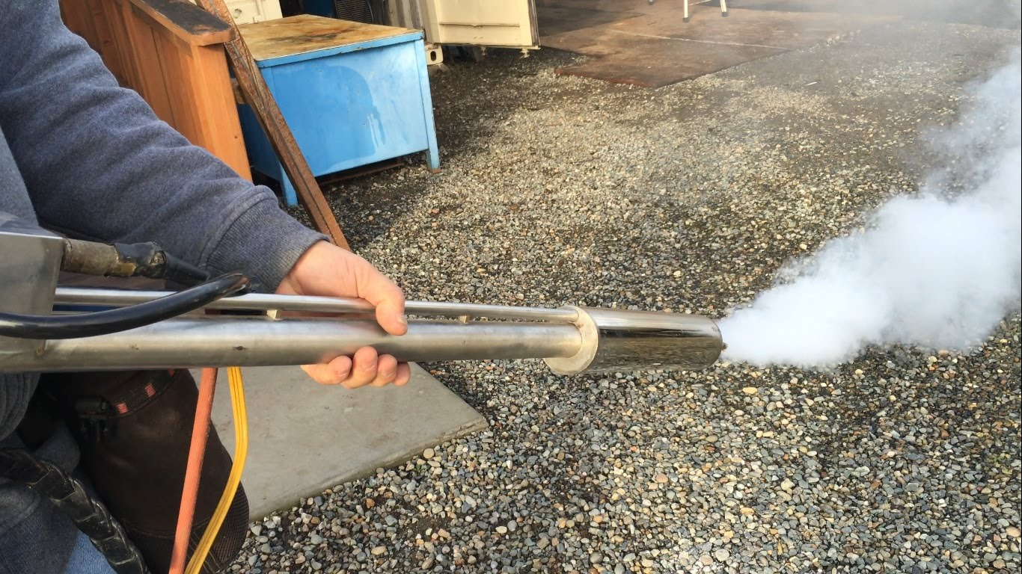
Application Methods
Notes:
It can be applied by trickling or evaporating.
~Trickling is the preferred method in Europe and Canada, where longer trials have occurred. The effectiveness of the trickle method is greater than 90%. Some of the studies have been done when there was some brood in the colony. When colonies were completely broodless, control was greater than 98%.
~Vaporization is gaining popularity in the United States, and we will talk more about that later.

Slide 35
Directions for Use - Trickling
Prepare a solution by dissolving 35 grams of oxalic acid in 1 liter of lukewarm sugar water (1:1 solution)
Treat in autumn or early spring (when little or no brood is present)
Most effective in broodless colonies
Treat when temperature is between 35-55 F (when bees are in a loose cluster)
Wear protective equipment
Notes:
For trickling you can
~Prepare the solution by dissolving 35 grams of oxalic acid in a liter of lukewarm sugar water. That sugar water should be a 1 to 1 solution. That means 1 to 1 by weight. If you use 4 pounds of sugar, you should use 4 pounds of water. It is helpful to know that there is 8 pounds of water in a gallon. If you are using a gallon of water, use 8 pounds of sugar to make a 1 to 1 solution. If you make a more concentrated solution, it may encourage the bees to consume it. You don’t want the bees to consume it. The purpose of the syrup is to make it sticky so it will adhere to the bee’s body. If you make a water solution of oxalic acid, it will just bead off and won’t work. So use a 1 to 1 by weight solution of sugar water, with 35 grams of oxalic acid in a liter of it. That’s enough to treat 20 colonies. If you don’t have 20 colonies, make less. This solution can be stored in the refrigerator, but it is best fresh and is certainly cheap to make.
~You want to treat in the autumn or early spring when little or no brood is present. Or you can artificially create a break in the brood cycle for treating, and we will talk about that.
~It’s going to be most effective in broodless colonies because it does not kill mites that are in capped brood cells. It only kills phoretic mites (those being carried about) that are on adult bees.
~You want to treat when the temperature is between 35 and 55 degrees Fahrenheit. You want the bees to be in a loose cluster. You want all the bees to be in the hive, but you don’t want a tight cluster because then you don’t get the distribution of the material that you need.
~And make sure to wear your protective equipment.

Slide 36
Break the Brood Cycle
1
2
3
1 2 3 4 5 6 7 8 9 10 11 12 13 14 15 16 17 18 19 20 21
Cage the queen on day 1
Release the queen on day 14
Treat on day 21
Notes:
If you need to create an artificial break in the brood cycle, here’s how you can do it.
~If you look at the row of numbers, that’s days of development for worker bees.
~First
~On day 1 you cage the queen.
~Second
~On day 14 release the queen.
~Third
~On day 21 treat for varroa.
That will give you a colony that is essentially void of sealed brood. By the time you are treating you will have eggs and larvae. One thing you need to do if you use this method is on day 4 and day 8 you need to open the colony and check for queen cells. If you cage the queen to where she can’t lay, sometimes bees will begin to make queen cells.

Slide 37
Treatment Considerations
Mix fresh
Do not treat weak or starving colonies
Do not use thick syrup. Use 1:1
Treatments when brood is present are significantly less effective
Treat when temperatures are above freezing and below 55 F
Do not mix and store for more than a week
Do not treat when honey supers are in place
Notes:
Some treatment considerations
~You want to mix oxalic acid fresh. If you mix it up and let it sit around for a week you will have a product that causes bees to have dysentery. So mix it fresh. It is inexpensive, mix what you will need for one treatment. Discard it, then make more fresh. Don’t let it sit around for any length of time.
~You do not want to treat weak and starving colonies. If you treat with the trickle treatment and come back in a week, if you spilled oxalic acid on the top bars, those beads of it should still be there. The purpose of the sugar is again, to make it sticky and make it adhere to the bees. You don’t want them to consume it. If you treat weak or starving colonies they will consume it. Do not use thick syrup. Use 1 to 1. If you use a highly concentrated syrup, the bees will sometimes consume it. The sweetness appeal will exceed the bitterness of the acid. So you want to always use 1 to 1 syrup.
~Treatment when brood is present is ineffective. As little as 15 to 20% of mites are on adults in July, Sealed brood protects varroa from all treatments.
And, as previously discussed,
~Treat when temperatures are above freezing and below 55
~Do not mix and store for an extended period of time
~And do not treat when honey supers are in place.

Slide 38
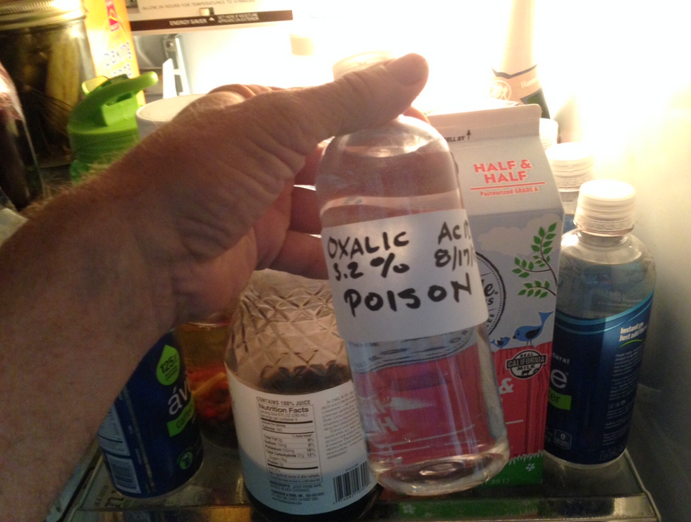
Store in the ‘fridge
Notes:
Randy Oliver advises that you can store excess mixture in the refrigerator. However, he advises to
not store in the ‘fridge if you have small children. The mixture tastes like lemonade. Always label the syrup as poison. It will keep for several months. Under warm storage, the acid causes a chemical reaction that turns the sugar into bee-toxic HMF. I’m not sure whether it creates enough HMF to harm the bees when dribbled, but no need to find out. Discard the solution if it discolors.

Slide 39
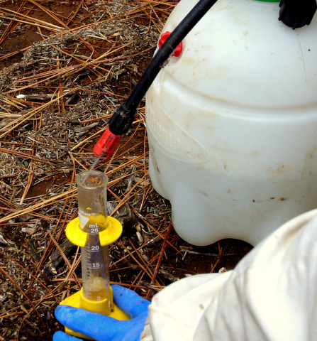
Trickle Treatment Application
Notes:
You have a 50 ml syringe that you are sucking it up and you are trickling 5-6 ml of product between each frame space. You can practice by sucking up water in the syringe, and slowly releasing it in an empty hive until you get the material evenly distributed in an amount of 5-6 ml per frame space. If your bees have a single story brood box, this is relatively simple. If it is a double-stacked brood box, you will need to break apart the boxes to apply this material in each frame space.
Or you could follow this same approach with a pump sprayer.

Slide 40
Recommended Amount of Solution
Five frame nucleus – 30 ml
Single story colony – 40 ml
Double story colony – 50 ml
Notes:
How much of this solution should you apply.
If you are treating 5 frame nuclei, 30 ml
If you are treating a single deep box, 40 ml
If you are treating a double deep box, 50 ml

Slide 41
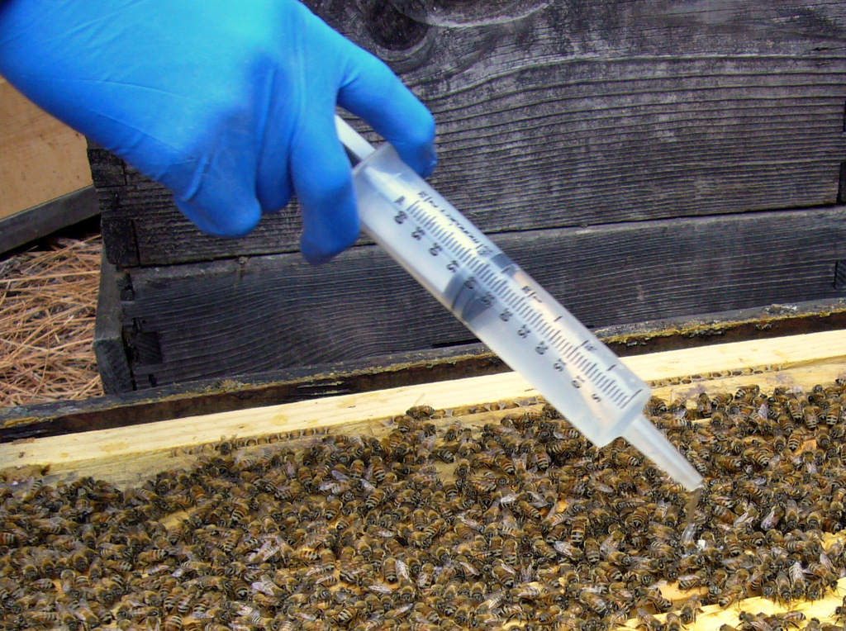
~5 mL per “seam” of bees
Notes:
The Europeans recommend not applying more than 50 mL in total to a colony in fall. Randy Oliver advises that in California (with a short broodless period), they apply 5 mL per seam, even if there are more than 10 seams of bees. He has seen no negative effect, but he cautions that there may be one where winters are colder and longer.

Slide 42
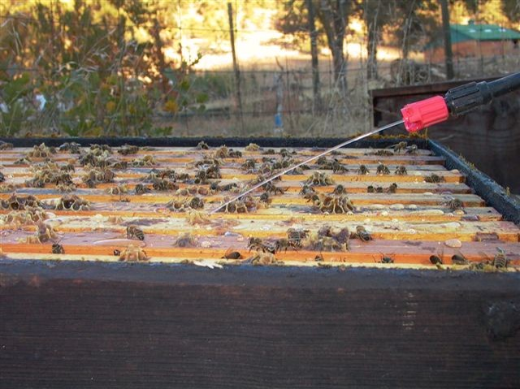
Dribble, not spray
Notes:
Do not be tempted to utilize the approach that more is better. I recall a presentation by Wendy Reed where she told a story that they had over-treated their hives with the “dribble” method. And what is a dribble, really? She said their poor hives had larvae literally crawling out of them. Of course, those hives died. Follow the manufacturers’ instructions!

Slide 43
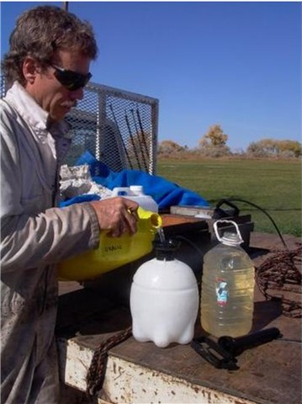
Protect your eyes
Notes:
There is always splashing—even though the solution is similar to lemon juice, you don’t want to get it into your eyes!

Slide 44
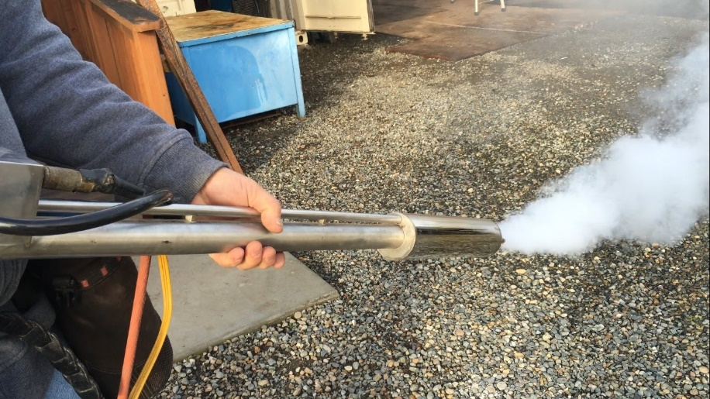
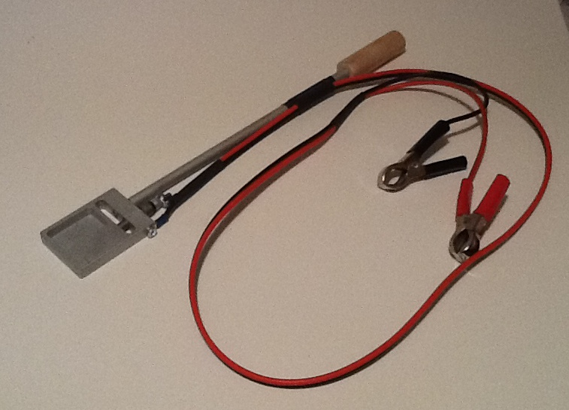
Vaporizer Application
Notes:
You can also apply oxalic acid by vaporization.
The top picture is a commercial operation, that most of you will likely never use.
On the bottom, is a vaporizer that has a chamber you put the material in. It has electrical connections you hook to a 12-volt battery and it sublimates that material and fumes up into the colony. The vaporization creates tiny crystals that evenly distribute throughout the hive.

Slide 45
Vaporizer Application
1 gram singles, 2 grams doubles
¼ teaspoon = 1 gram
Seal entrances while treating and for 15 minutes post treatment
Allow 2.5 minutes to evaporate (be sure to disconnect power when done)
Cool thoroughly before reloading
Notes:
~If you are going to sublimate, or vaporize your oxalic acid application, you want to use 1 gram for singles, and 2 grams for doubles.
~If you don’t have a scale, you will use about ¼ teaspoon for a single, and ½ teaspoon for doubles.
~You want to seal the entrances while treating and for 15 minutes post-treatment.
~You need to allow 2 ½ minutes for the treatment to evaporate, and be sure to disconnect the power after that time.
~You need to then remove your evaporator, let it cool a little bit, and then you can do final cooling by dipping it in a pail of water. (I, personally, am uncomfortable dipping my vaporizers in a pail of water. The connections would be submerged. I just wait for it to complete cooling.) You want to make sure it is thoroughly cool before adding new material because if you bring it out, and it is hot, and you add new material to it, it will sublimate right at your face.

Slide 46
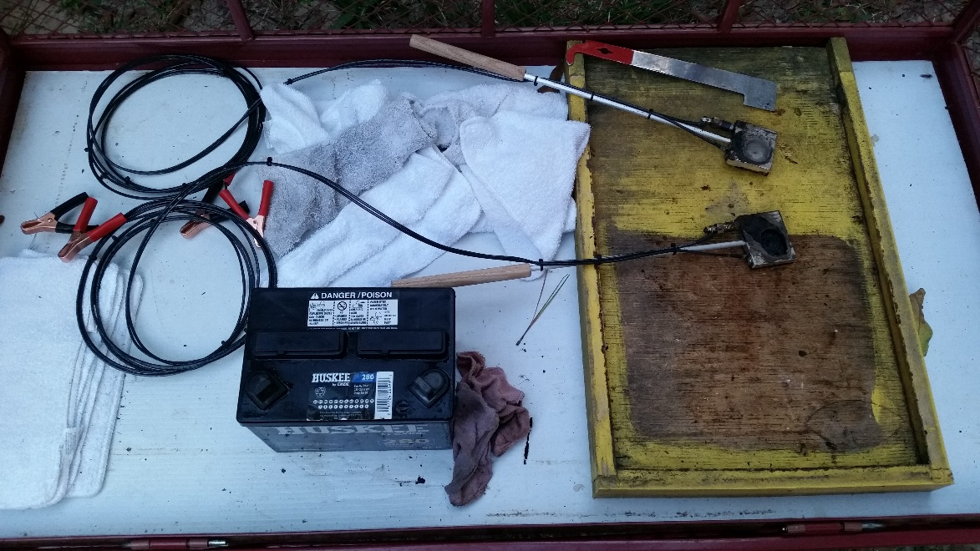
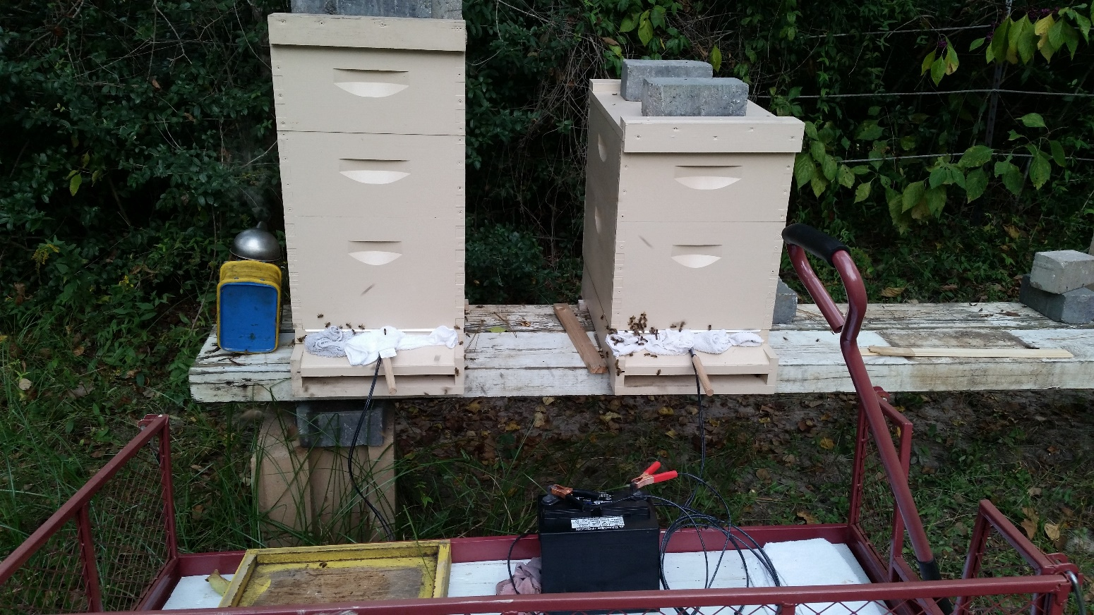
Vaporizer Application
Notes:
~You will need these tools to utilize the vaporization method of oxalic acid application. I use my garden wagon to haul it all around. I also utilize an old solid bottom board to stop the hot applicator from melting the plastic base I have in the wagon. You will need a fully charged 12-volt battery for the sublimation. You will also need some old rags
~Place the oxalic crystals in a COLD vaporizing tool. Insert the tool into the hive. You will probably have to take out the entrance reducer to fit the vaporizing tool into the hive. Chase as many bees as you can into the hive with your smoker. Fill all openings with the old rags. Do not waste your time on this method if you have screened bottom boards (unless it is a Freeman bottom board, then just insert the tray). Hook the vaporizing tool up to the car battery and wait. Online instructions said 2.5 minutes. My experience is it takes more like 5-7 minutes. Disconnect the vaporizer from the car battery. Wait 15 minutes before removing the rags, and the somewhat cooler tool. Wait for tool to cool completely before adding more acid for treating the next hive.

Slide 47
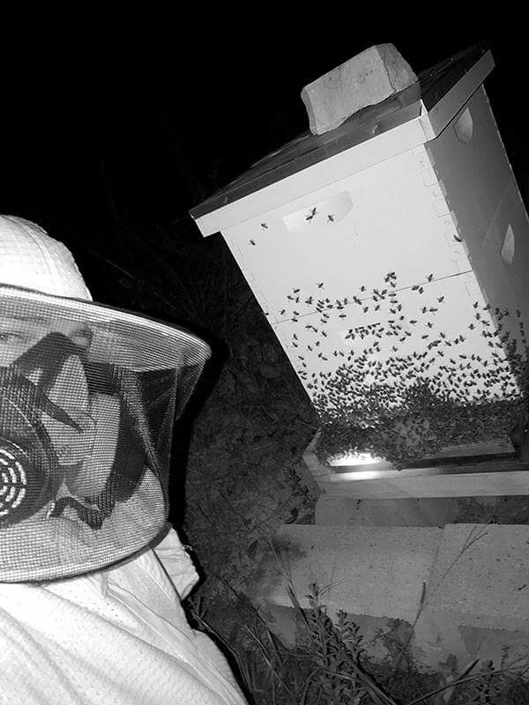
Vaporizer Application
Notes:
But make sure………ALWAYS…………..that you use your respirator when utilizing the vaporization method. Oxalic acid fumes are dangerous when inhaled. Make sure you are upwind of any potential fumes, and wearing protective gear.

Slide 48
Summary

Slide 49
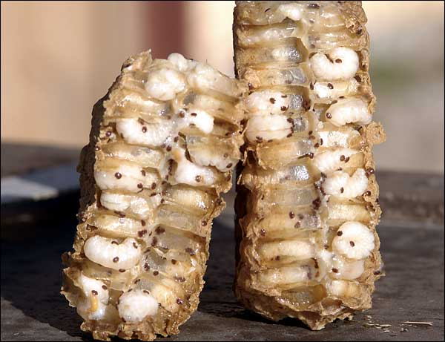
http://www.sbai.org.uk/
Oxalic won’t kill mites in the sealed brood.

Slide 50
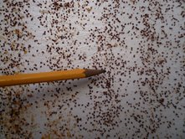
Oxalic drops mites for about 4 days.
Notes:
This photo is from one of Randy Oliver’s first oxalic dribbles. You don’t ever want to see this many mites!

Slide 51
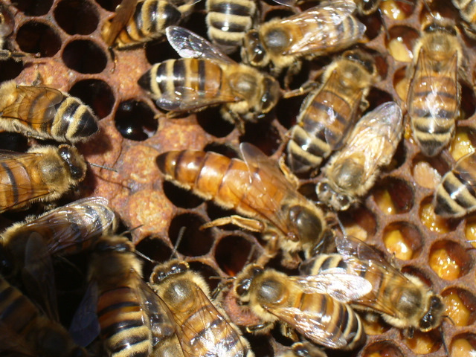
Doesn’t appear to harm queens
Notes:
Several studies, as well as my own experience, shows no noticeable negative effect upon queens, even new queens in nucs.

Slide 52
Dribble vs. Sublimation
Dribble |  | Sublimation
Pros: | High efficacy | Pros: | Perhaps higher efficacy
 | Very safe to apply |  | No opening of the hive
 | Quick |  | Can do in freezing weather
 | Little equip needed |  | Perhaps gentler to the bees
 |  |  | No syrup mixing
Cons: | Requires opening hive | Cons: | Vapor fog is hazardous
 | May be problematic in freezing weather |  | Requires specialized vaporizer and energy source
 | Easier with helper |  | Problems with hot tip
Notes:
Each method has pros and cons.

Slide 53
Bloom Honey Co
Notes:
Rotate your treatments. It is imperative that you don’t use one exclusive form of treatment, which will only breed resistant mites.

