Slide 1
Labeling, Marketing and Selling Honey
For the Small Scale Beekeeper
By Michelle Gasaway
Montgomery County Beekeepers Association

Slide 2
Labels and Bottles
LABELS: Bee Creative, Clear and Custom
Follow State guidelines – Senate Bill 1766 – eff. 9/1/15
BOTTLES:
Plastic weighs less than glass
Shop around for the best price (including lids)
Consider a group order to get discounts
Offer various sizes to reach more customers
Decide what shape you like best and be consistent in your offerings
Mason Jars – economical and nostalgic

Slide 3
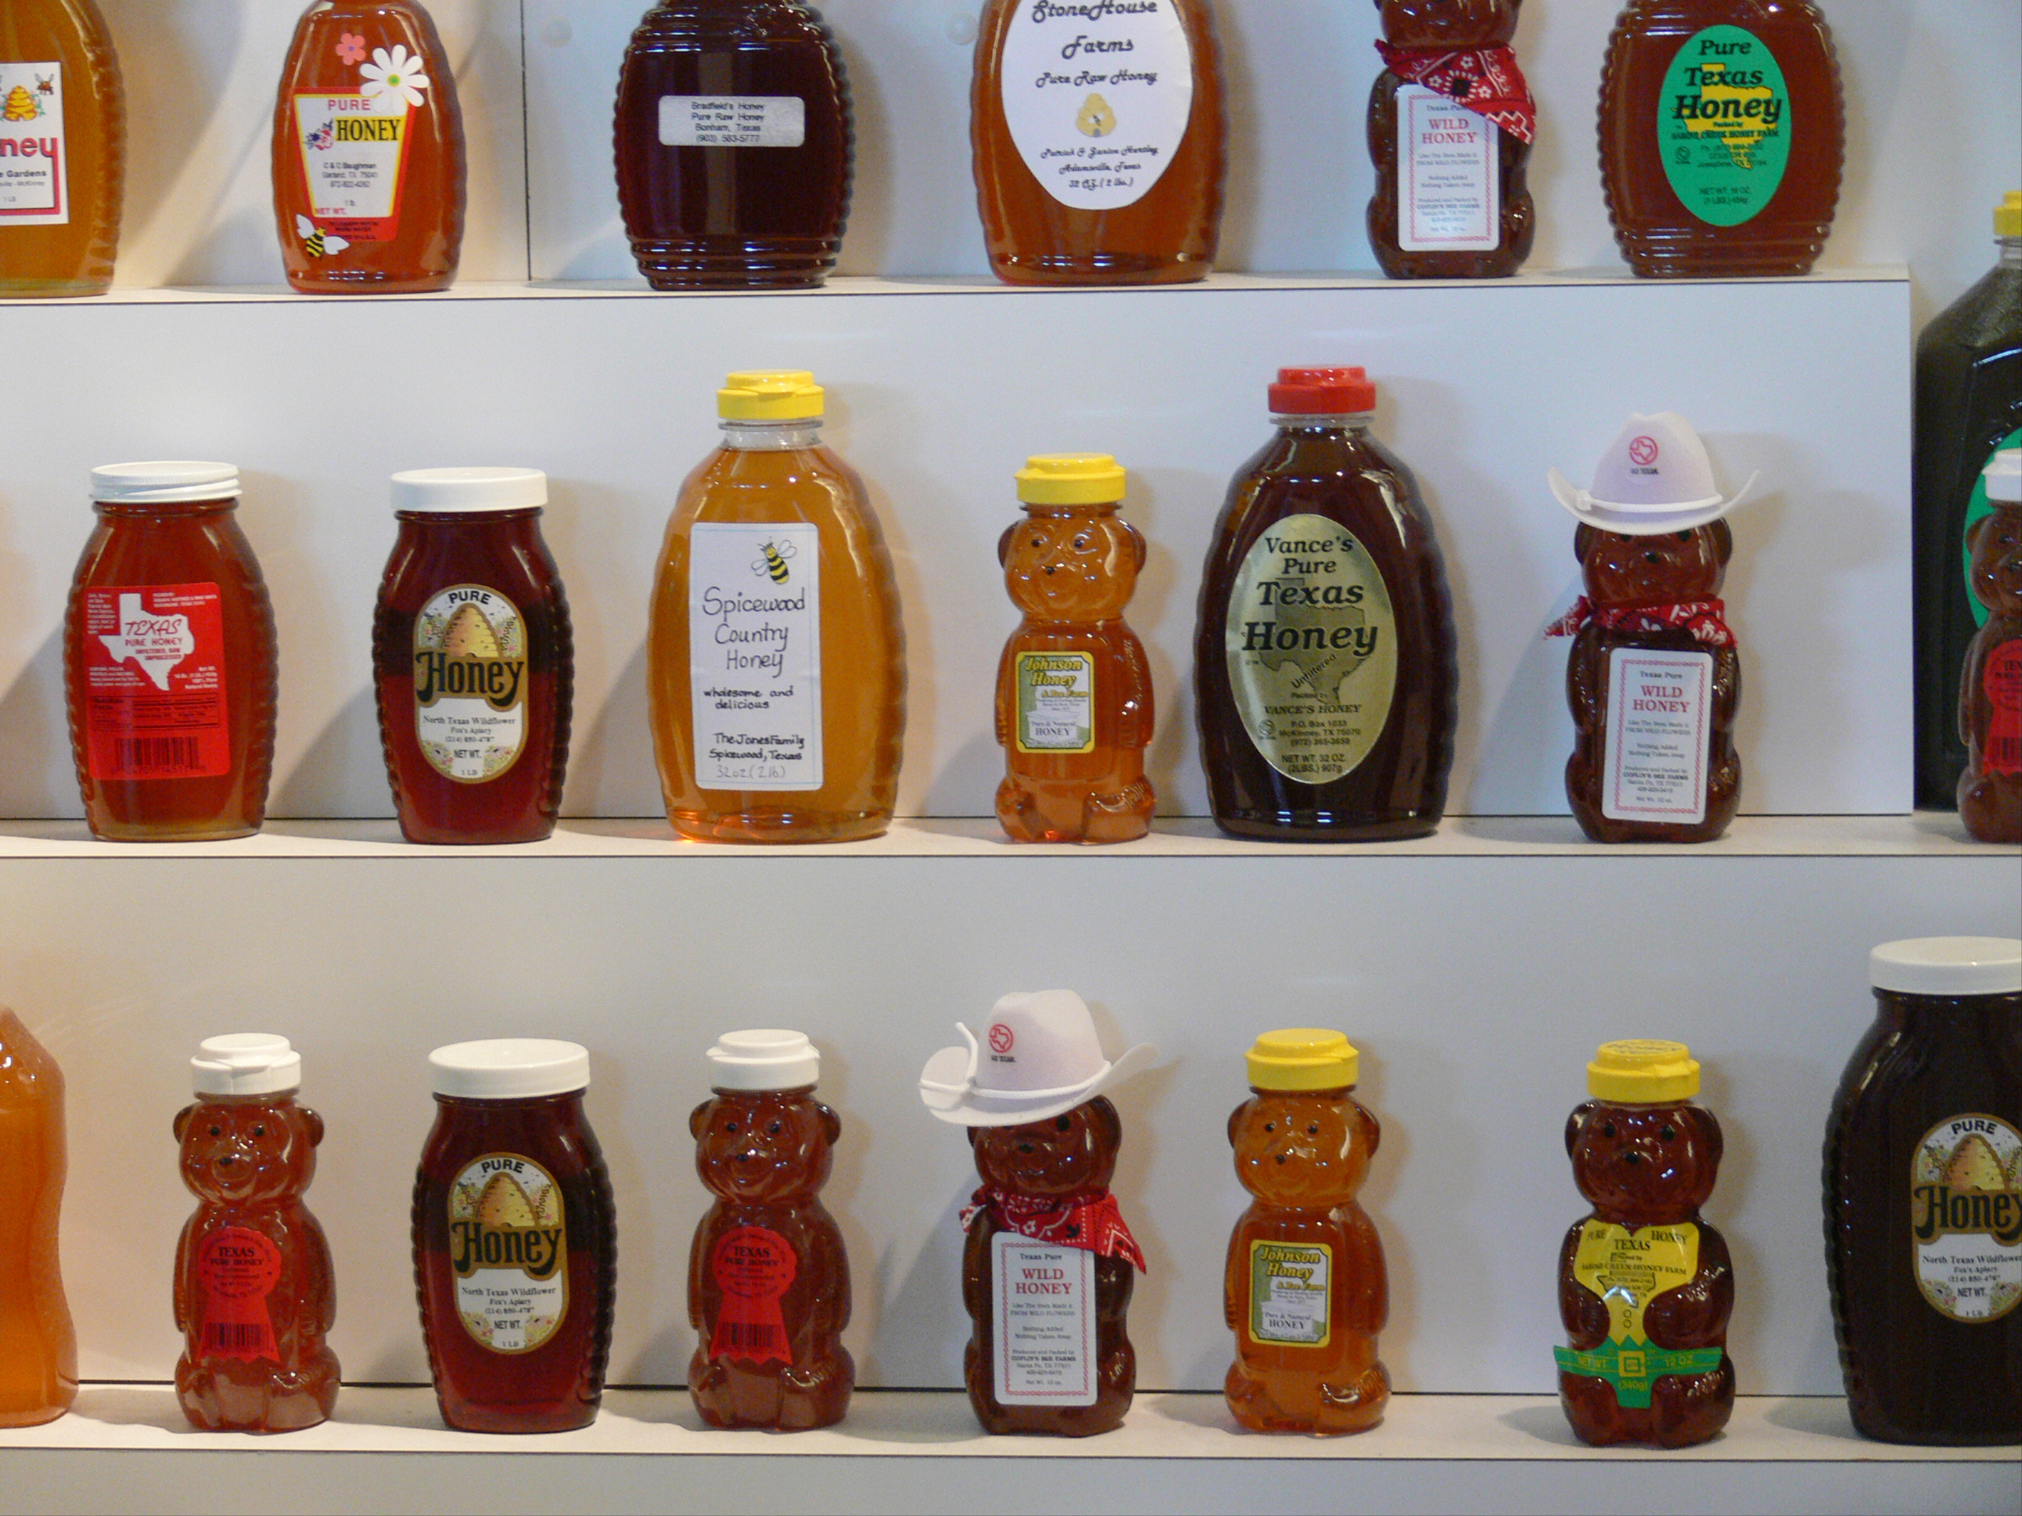

Slide 4
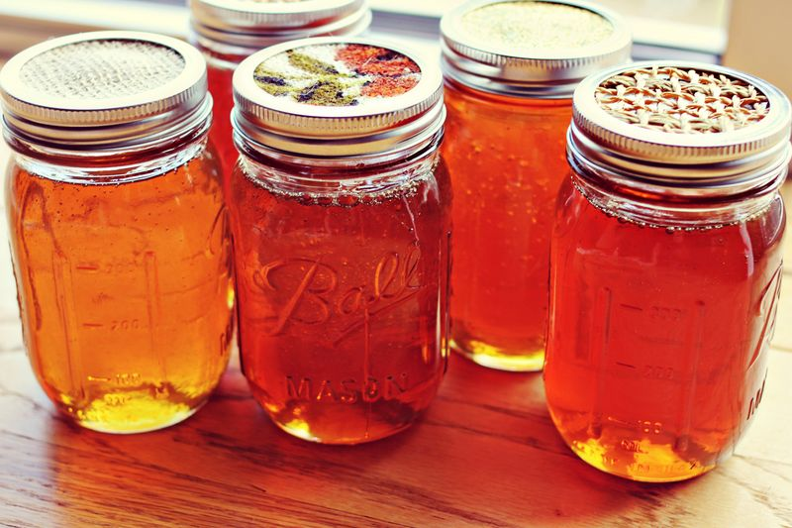

Slide 5
Agriculture Code Title 6, Subtitle A, Chapter 131
Subchapter E. Labeling and Sale of Honey
Sec.131.081- 131.084
Internet search: Ag Code 131

Slide 6
A person may not label, sell, or keep, offer, or expose for sale a product….
as “Honey” unless the product consists exclusively of “Pure Honey”
that resembles” Honey” that is labeled with a picture or drawing of bee, beehive or comb unless it’s “Pure Honey”
resembles “Honey” and is labeled as “Imitation Honey” (no such thing as IMITATION HONEY!)
that consists of “Honey” mixed with another ingredient unless:
the product contains an “Ingredient Label”
the word “Honey” appears in the list of ingredients in the same size print and location
***Disclaimer: This is a summary, not word for word of Ag Code 131***

Slide 7
Senate Bill No. 1766
Effective 9/1/15
A Bill to be Entitled an Act relating to exemptions from certain regulations for small honey production operations.
small honey production operation
less than 2,500 pounds PER YEAR
selling of honey must be done by the beekeeper and/or immediate family
only sells or distributes honey or honeycomb:
produced in Texas
owned and managed by the beekeeper
that is pure honey (raw and not blended with any other product)

Slide 8
sells directly to consumer
From Beekeeper’s home
At a farmer’s market
At a farm stand
municipal, county, or non-profit fair, festival or event
AND deliver the honey to the consumer at the point of sale or another location designated by the consumer.
***Disclaimer: This is a summary, not a line by line depiction of S.B. 1766***

Slide 9
LABELING REQUIREMENTS FOR SMALL HONEY PRODUCTION OPERATION
Must be labeled in accordance with Subchapter E
Chapter 131 Ag Code

Slide 10
Labeling must include:
Net weight in both avoirdupois(ounces/pounds) and metric
Beekeepers name and address
the statement “Bottled or packaged in a facility not inspected by the Texas Department of State Health Services”
Optional statement: “Do not feed honey to infants under 1 year of age”

Slide 11
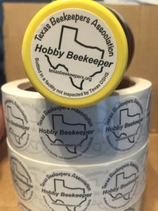
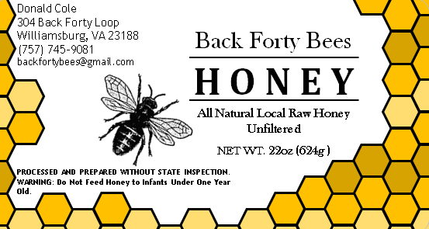

Slide 12
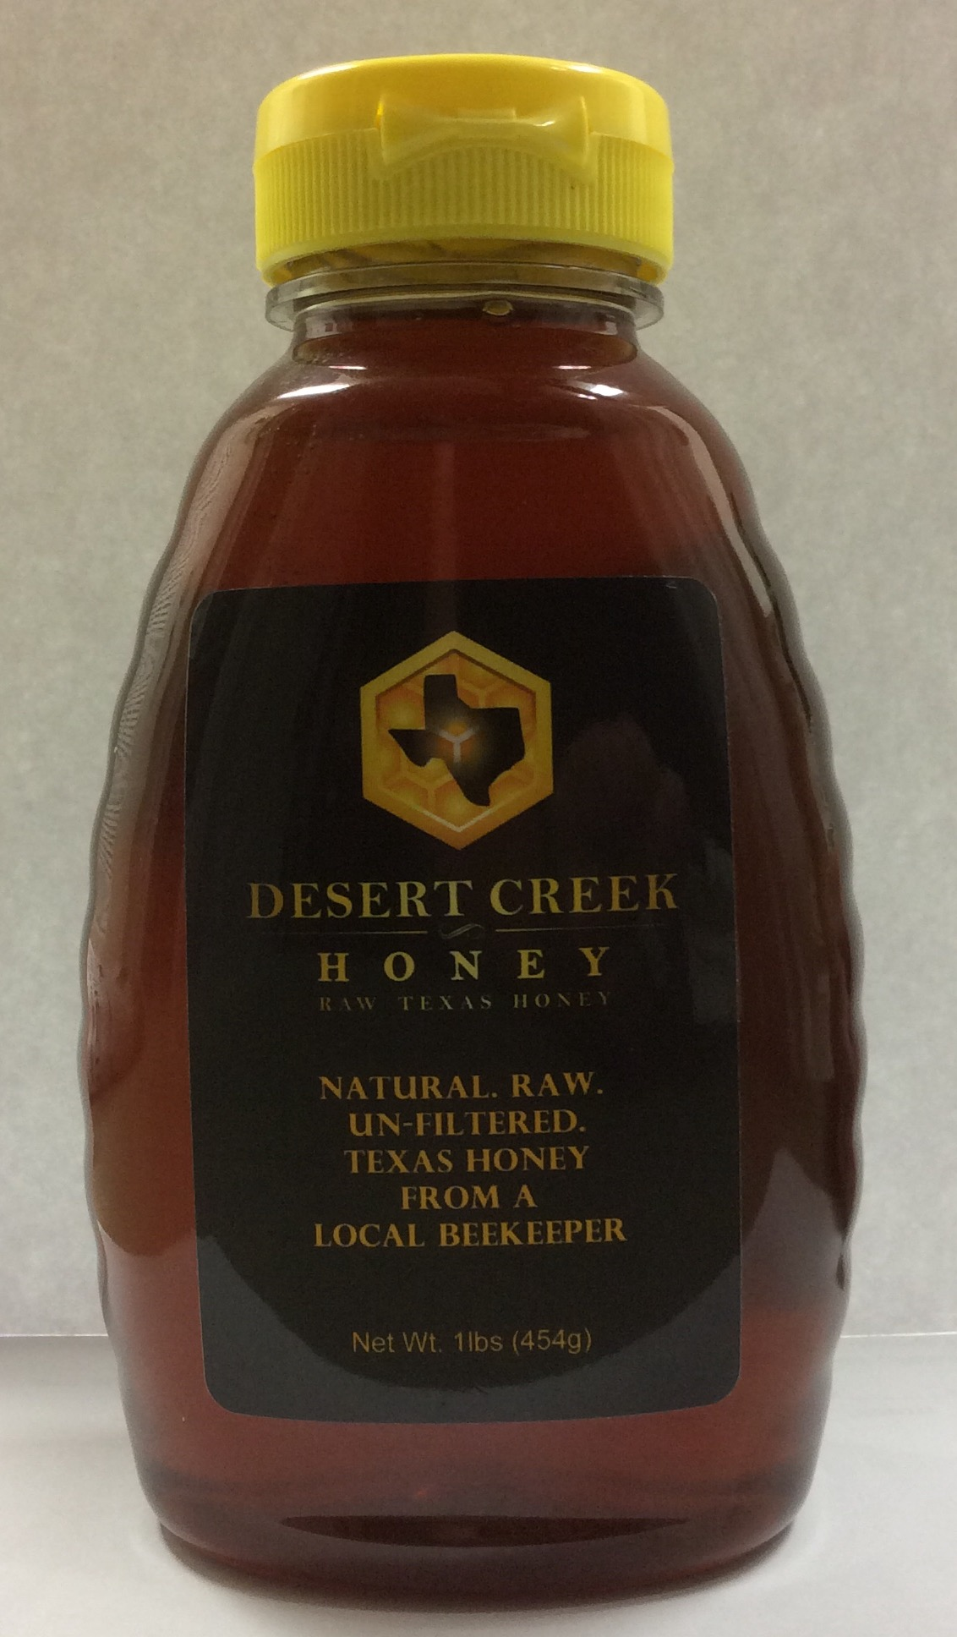
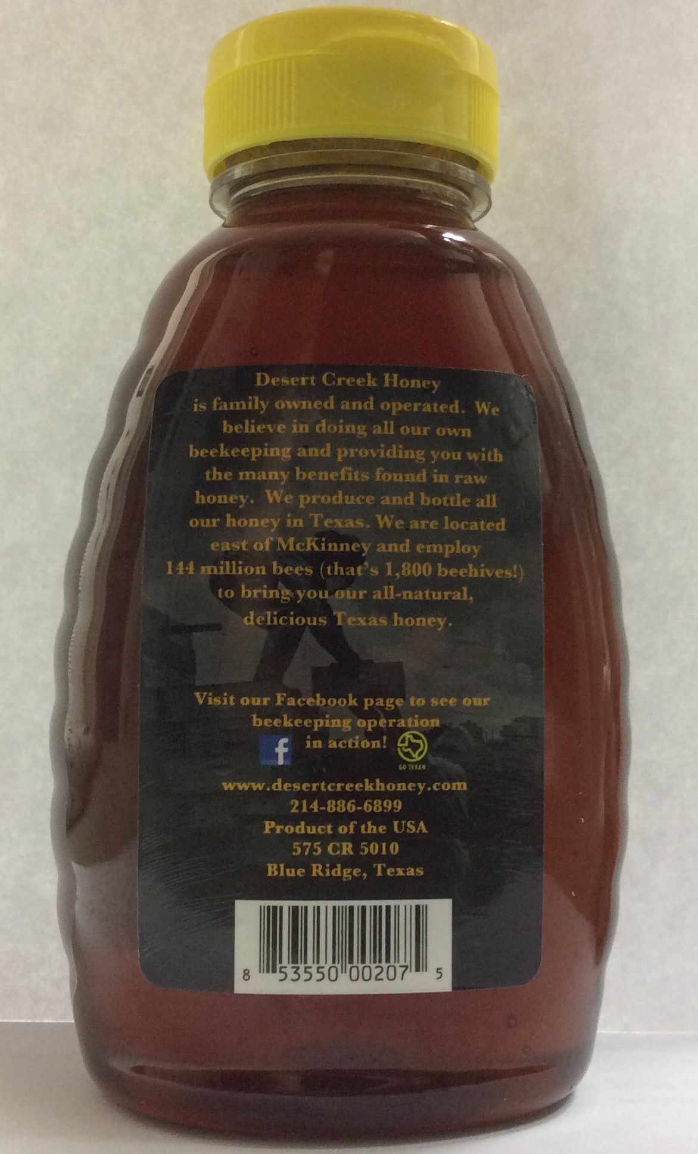

Slide 13
****Important****
REGULATION OF SMALL HONEY PRODUCTION OPERATION PROHIBITED.
A local government authority, including a local health department, may not regulate the production of honey or honeycomb at a small honey production operation.
Notes:
A

Slide 14
What does this mean to you?
Beekeepers are not required to obtain a Food Manufacturers License
Not required to have a Health Department approved honey house
No inspection of bottling facility

Slide 15
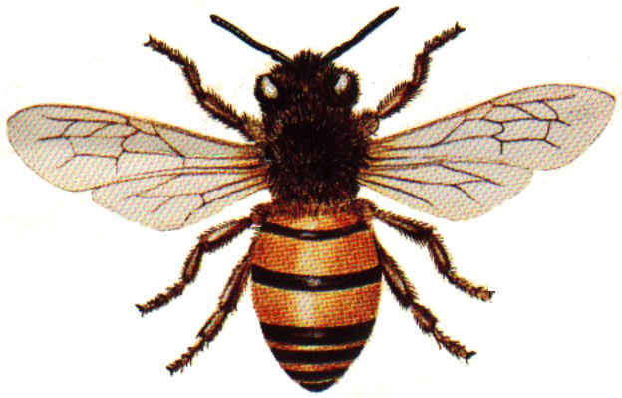
BEE CLEAN!
ALWAYS MAINTAIN
A SANITARY ENVIROMENT
FOR BOTTLING YOUR HONEY!

Slide 16
Marketing your Honey
ADVERTISE!
This does not have to cost an arm and a leg…
Word of mouth is the best advertising so, give some away to your family, neighbors and friends, ask them to spread the word.
Put up a sign in your yard, at your local feed store and convenience store
Post a FREE Ad on Craigslist or other local sources/message boards
Place an Ad on the Radio 99.9 KSHN (Liberty)
Use Social Media (Facebook, Twitter, Linked In, etc.)

Slide 17
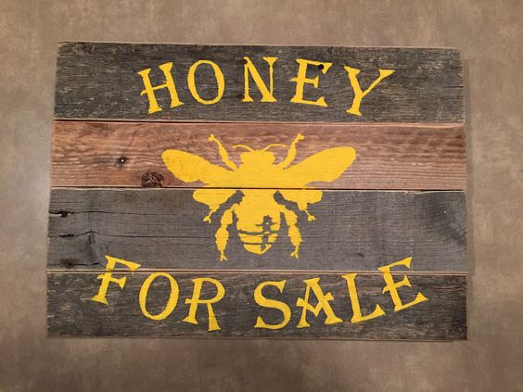

Slide 18
Marketing (Cont.)
Create a website – FOR ADVERTISING ONLY**
Get some cards made…Vistaprint has great prices & you design it yourself!
Leave your contact information at your local health food store, coffee shop, nail salon, anywhere you do business.
Call your local newspaper
Reach out to Boy & Girl Scout troops

Slide 19
Selling your Honey
PRICING:
Don’t sell yourself short!
Don’t undercut the competition…it is bad for all beekeepers
A good rule of thumb is $1 per ounce, offer discounts for larger quantities
WHERE to sell:
Texas laws limit where you can sell, per the Senate Bill 1766
Must be sold directly to the consumer
Attend a Farmer’s Market, Church Bazarr or Holiday Fair
Set up an Honor System Honey Stand

Slide 20
Extras!
Make Meade from excess Honey
Use/sell other products of the hive
Beeswax
Candles
Soap
Lip Balm
Skin salves
Propolis – natural antibacterial
Bee Pollen
Bee Larva
Dead Adult Bees….yes...you can sell dead bees!

