Slide 1
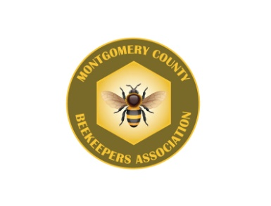
Maximizing Honey Production
James and Chari Elam

Slide 2
One of the main reasons for keeping bees is to harvest the honey that bees store in their hives.
~~~~~~~~~~~~
The amount of honey produced per colony depends on a number of factors…

Slide 3
Availability of bee forage area
The Queens condition
Hive population
Nutrition
Swarming
Space for expansion of the brood nest and honey storage
Keeping the colony free from disease
Beekeepers experience
Weather

Slide 4
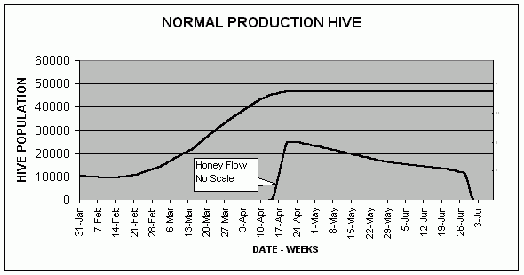
Our Focus
Maximizing honey yield by optimizing Honey Bee Population
Illustration credit: Huge Feagle, Leeds, AL

Slide 5
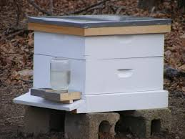
Population
+
30,000
30,000
Does NOT equal 60,000
WHY?

Slide 6
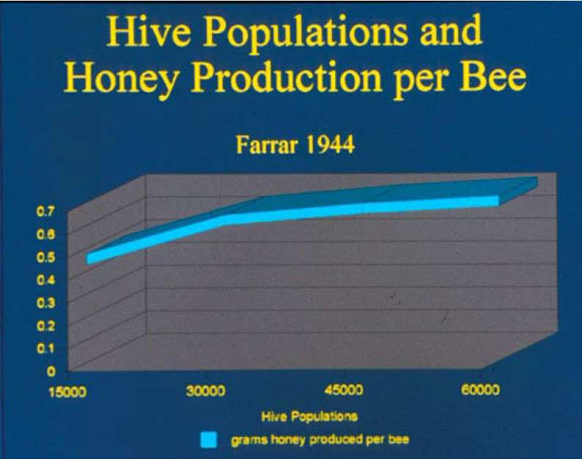
Large colonies disproportionally produce more honey than smaller ones!
A colony of 60,000 bees will produce more honey than 2 colonies of 30,000 each combined.
Illustration by: Richard Farrar

Slide 7
Keeping your population healthy is key ALL YEAR ROUND!
Treat for pest
Feed when needed
Keep a young Queen

Slide 8
Why a young Queen?
Less likely to swarm
First year queen is genetically programmed to focus her efforts on building a colony and storing honey for winter!
Produce more brood than older queens

Slide 9
And…
Larger queens produce more eggs, therefore the colony will contain more bees, in turn including more foragers to gather a larger honey crop!

Slide 10
Population Management by Season

Slide 11
***Early Spring***
FEED, FEED, FEED your bees!
Stimulative feeding (1 to 1 ratio) in spring is one of the most effective population building techniques.
Regardless of where a hive is located, the important thing to remember is that it takes about 6 weeks to go from egg to forager.
Early stimulative feeding insures that there is sufficient population in time for honey flow!
BUILD YOUR POPULATION BEFORE THE FLOW AND NOT ON THE FLOW!

Slide 12
Swarm Prevention
And
Expanding the Brood Chamber
Pyramiding is one of many techniques that can be used to give the queen and workers instant access to two brood boxes thus increasing population while reducing crowding which in turn prevents swarming!
Pyramiding is done at the time a second brood box is added to a hive that has one brood box.
You’ll want
Drawn frames for best results

Slide 13
****Very Important****
As with any hive, the brood chamber
SHOULD NOT BE DISTURBED DURING THE HONEY FLOW!!!

Slide 14
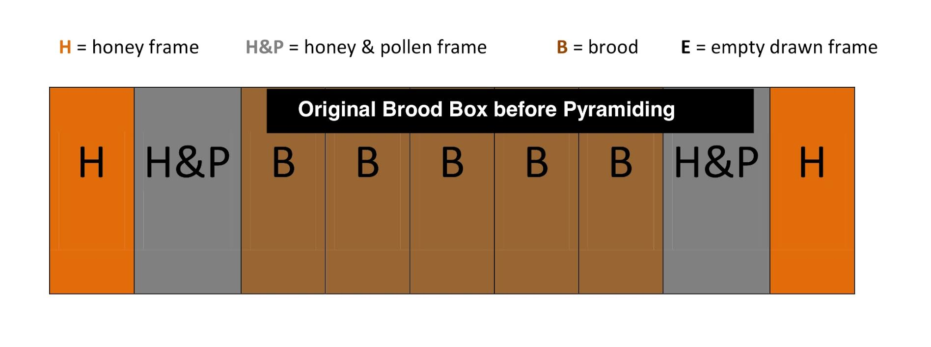
Typical Brood Box

Slide 15
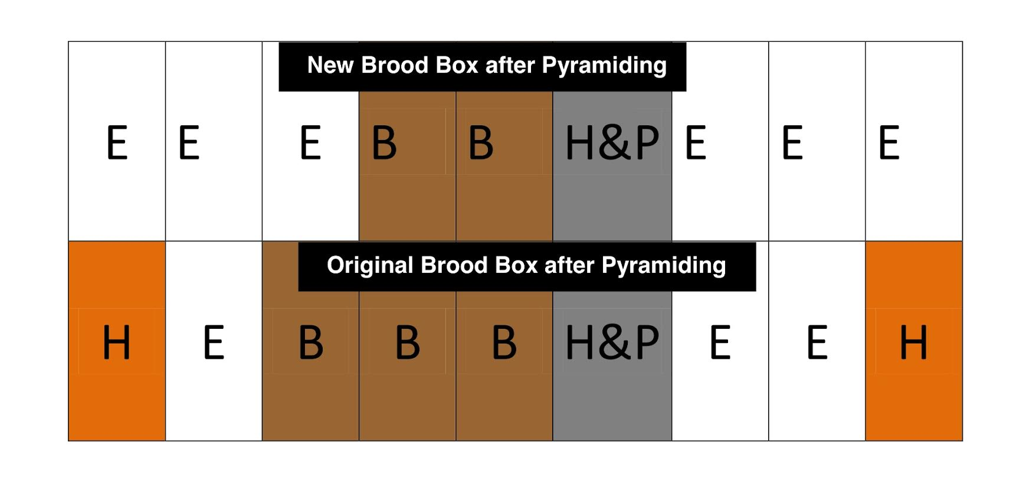
Pyramiding Brood
To make
2 Brood Boxes

Slide 16
Avoid Swarming
Swarming reduces honey production due to the loss of bees, as the old queen leaves, taking more than 30-60% of the bees of the parent colony.
Inspect your colony regularly every 7-10 days
Remove or re-use Queen/Swarm cells

Slide 17
Spring
Continue to feed until Honey Flow begins
Insure access to fresh water
Control Pest (i.e. hive beetles)
Remove mite strips prior to adding supers
(follow instructions on packaging to the letter)
Keep colonies crowded while increasing space for growth

Slide 18
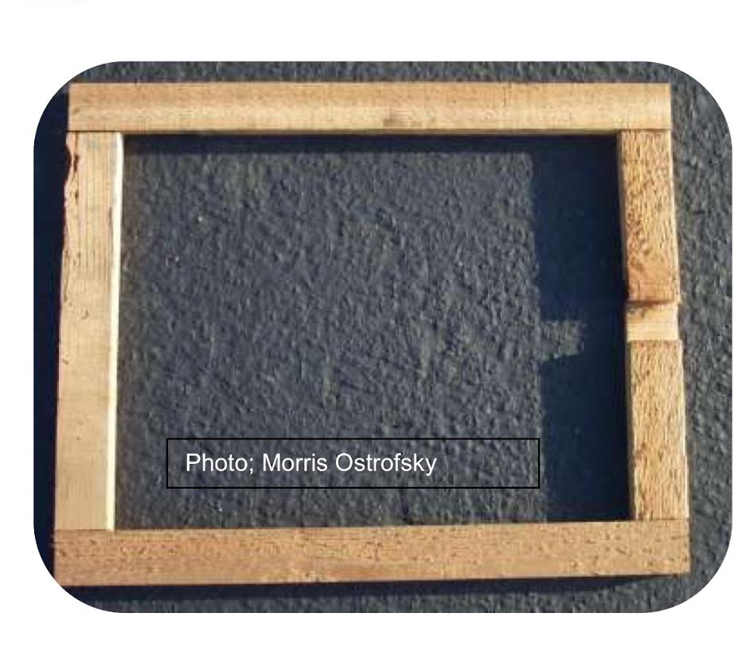
Late Spring/Early Summer
This is when the colony population reaches its peak!
Coordinate equipment with the population to optimize honey yield
Supers and Imerie shims (for creating an upper entrance) are the tools you need!
Adding supers based on 70% rule

Slide 19
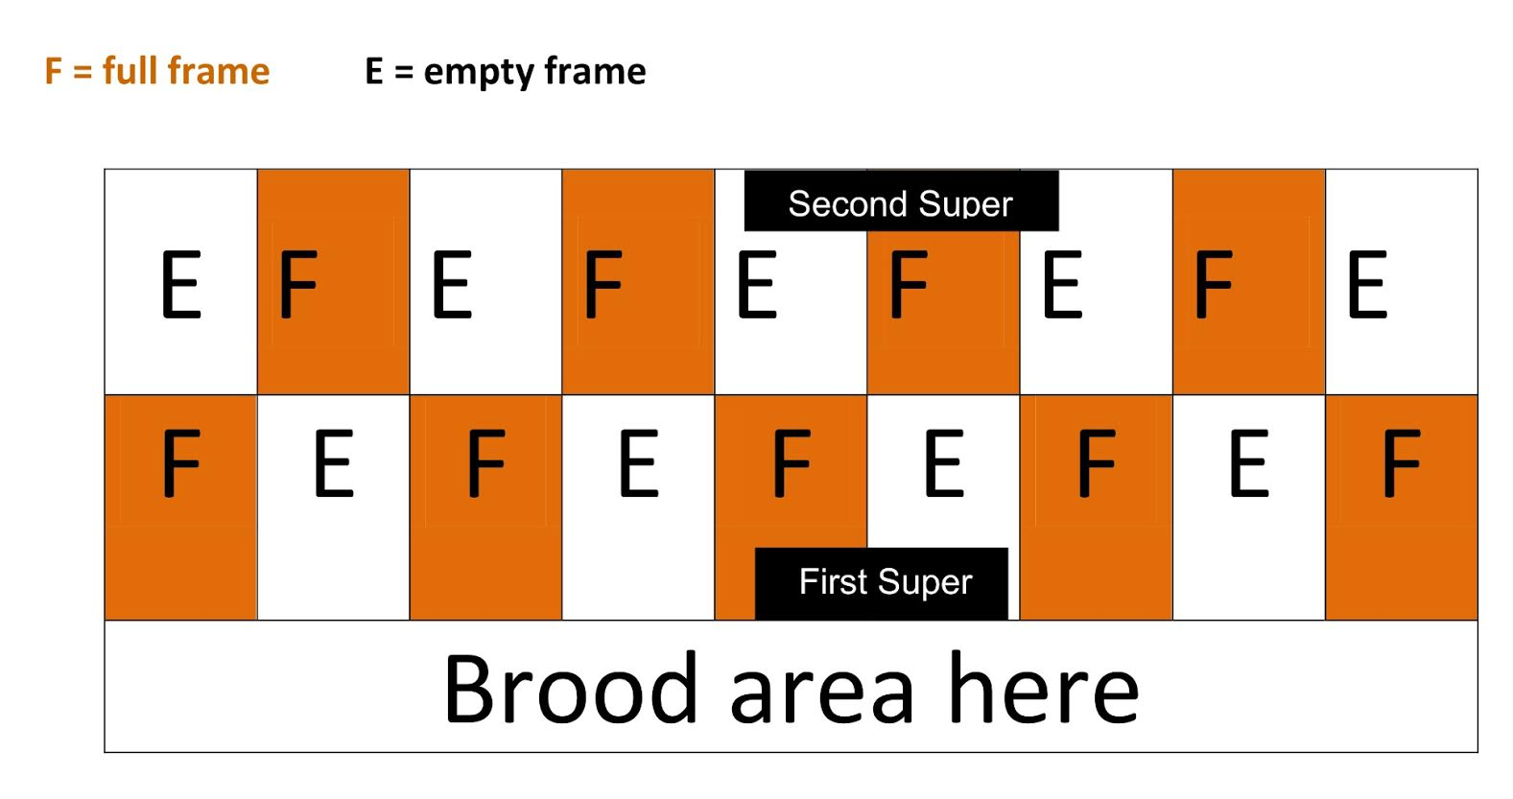
Checkerboarding
Supers

Slide 20
Summer
Feed during dearth
It is cheaper to feed syrup than for them to consume your valuable honey!
Continue Hive Beetle management
As supers are extracted and not being refilled, do not reinstall
Maintain good ventilation

Slide 21
Fall
Remove all supers if not having done so already
Leave ample honey stores for the colony (40-60lbs)
Begin treating for Varroa Mites
Combine weak colonies
Consider relocation to “greener pastures” if necessary
Re-Queening in Fall is optimal
Why?

Slide 22
~~Ideally~~
Re-queening with a mated queen should be done at the end of summer or in fall.
Introducing a queen in the fall means you do not interrupt brood production in the spring.
Spring re-queening has disadvantages…
Interrupts brood production
And early spring queens typically are not as well mated as fall queens (not as many drones)!

Slide 23
Winter
Feed 2/1 syrup (may add Fumagillan to prevent Nosema)
(According to Dr. Frank Eischen feeding Fumagillan as a preventative has a short term negative effect but a long term positive effect..Oct. 2012, Western Apicultural Society Conference)
May add pollen patties
Avoid disrupting the colony
Continue to treat for Varroa Mites
Make sure that condensation is prevented from dripping on the winter cluster
NO “Hive Inspections” during the Winter

Slide 24
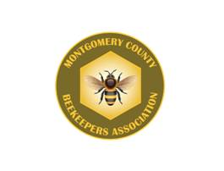
References:
Morris Ostrofsky – Master Beekeeper Washington State
Khalil Hamdan – The Netherlands
Lawrence John Connor – Queen Rearing Essentials
Bee Culture Magazine (February 2009 )
Carl J. Wenning -(1998) Maximizing Honey Production, American Bee Journal
Kim Flottum – (2011) Better Beekeeping, Quarry
Walter Wright – Nectar Management Principle and Practices
George Imerie – (August 1999) George Imerie’s Pink Pages
Brother Adam – (1983) In Search of the Best Stains of Honey Bees
F.E. Moeller – (October 1980) Agricultural Handbook
Jan Suszkw – (February 2002) Bee Culture, The Latest on Russian Bees, p2
James and Chari Elam 2015

Slide 25
All content in this program was comprised from information acquired by the producer through personal study and Internet provided materials. Photos and content are NOT the sole property of the producer and should NOT be accredited to that producer, but instead to the individual or entity that produced it. The Texas Beekeepers Association takes no responsibility for the content, its reliability or credibility. No copyrights were willfully compromised and the TBA avails itself of any and all legal liability from this production. Any duplication or alteration of this document/program is strictly prohibited.

