Slide 1
Varroa Mites – August Is “The” Month
– August 2017 –
Micky Cross
Co-First Vice President

Slide 2
Overview
Why August Is Important
Integrated Pest Management
Sampling
Treatments
Summary of Options
August is “Monitor & Decide” Month

Slide 3
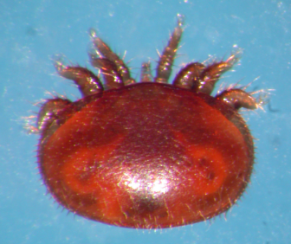
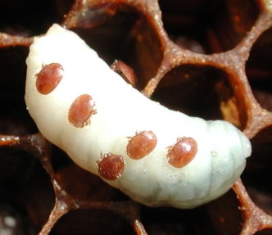
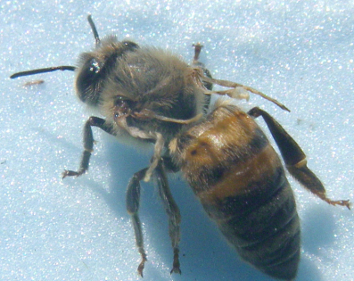
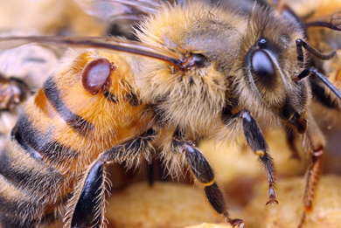
Some Background
Having A Few Mites In The Hive Isn’t A Problem For The Colony.
Varroa Becomes A Problem If The Bees Can’t Keep The Mites In Check
That Level Used To Be Surprisingly High > 25,000 Mites!
Led To The Original “Safe” Numbers Being Relatively High
But Now Viruses, Notably Deformed Wing Virus (DWV), Have Evolved To Take Advantage Of Varroa As A Vector.
This Dramatically Reduced The “Safe” Level
Most Hives Can’t Survive More Than ~1000 Mites Going Into Winter
“Safe” Numbers Now Much Lower
So, The Problem Is Really A Varroa And DWV Problem
Going Into Winter / Starting Spring With A Low Mite Count Is Critical

Slide 4
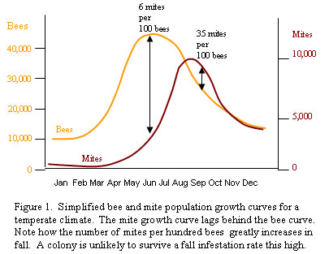
Why Is August So Important?
Bee Population Growth Has Started to Decline -- Mite Population Growth Hasn’t
Honey Supers Are Off (A Must For Most Treatments)
New Brood Is Low ( A Good Idea For Most Treatments)
August Is The Month To Decide Your Course Of Action For Each Hive
If Treatment Is Warranted, Treat By Mid-October
August Is Monitor & Decide Month – Then Act

Slide 5
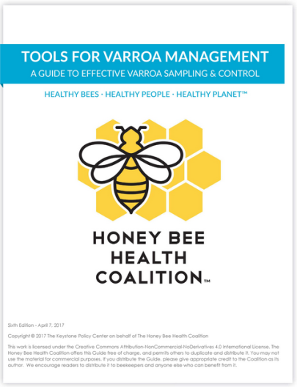
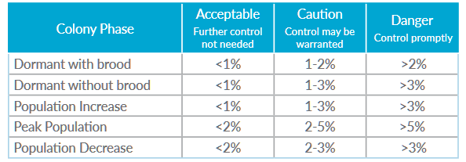
Integrated Pest Management (IPM)
So, August Is The Time To Decide A Course Of Action.
But, What Are The Alternatives?
Integrated Pest Management (IPM)
Honey Bee Health Coalition
http://honeybeehealthcoalition.org/
Doing Nothing May Be Fine

Slide 6
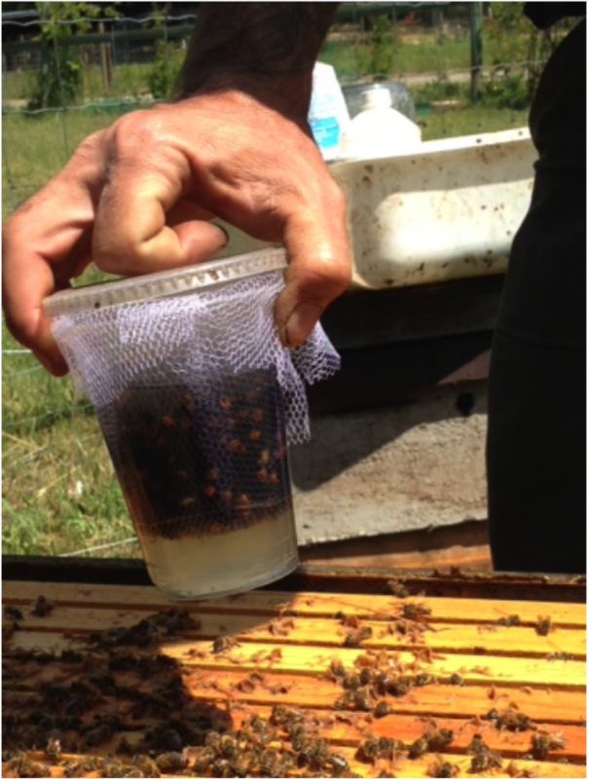
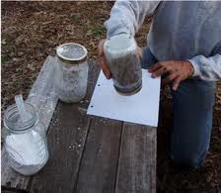
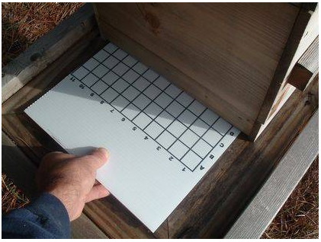
Sampling
Alcohol/Soap Wash
Powdered Sugar Shake
Drop Boards
See the Tools for Varroa Management Guide and/or the Sampling Methods video to learn how to use them.
While mite densities may vary across colonies, all colonies in an apiary should be treated at the same time with the same chemical or non-chemical technique.

Slide 7
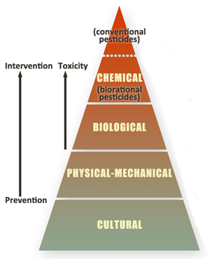
Treatment: “An” IPM Pyramid
Amitraz (Apivar)
Fluvalinate (Apista) Coumaphos (CheckMite+)
Miticides
Oxalic Acid
Formic Acid MAQS
MAQS (Mite-Away Quick Strips)
Hops Beta Acids
HopGuard II
Organic Acids
Essential Oils
Thymol (Apiguard)
Thymol + Others
ApiLife Var
Powdered Sugar
Do Nothing
(i.e. “treatment free”)
“The” IMP Pyramid

Slide 8
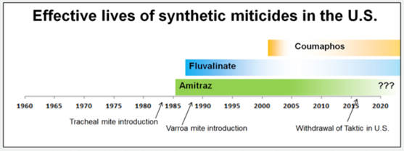
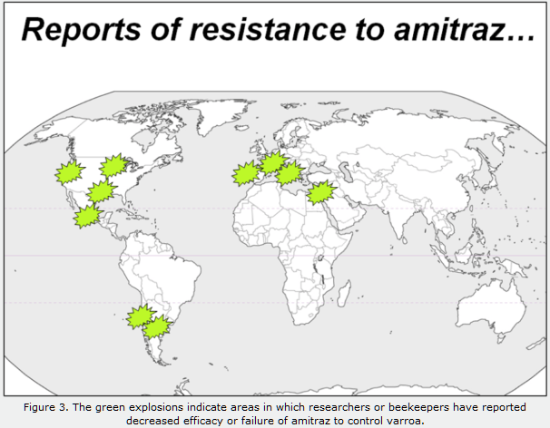
Miticides - A Declining Method -
Studies at Texas A&M Honey Bee Lab Indicate Growing Level of Amitraz in Comb
Mites Have Shown A Strong Ability To Evolve Resistance To Pesticides
Pesticides Bring Along Many Associated Problems
Commercial Operations May Still Need/Use Them, But Use Is Declining
My Recommendation: Don’t Use Miticides

Slide 9
Treatment Free
Subject Of A Long-Standing & Very Heated Debate
Pros
Allows Natural Selection To Operate
Bees Adapt Over Generations and Develop Resistance
Working In Feral Population
Does Not Introduce Chemicals Into The Hive Or Expose Bee Keeper
Cons
High Loss Of Hives Until Evolution Wins
Dying Hives Increase Mite Counts Of Nearby Hives (Robbing)
“Mite Bombs” -- Be Prepared To Have Upset Bee Keepers Around You
Intentionally Letting Creatures Under Your Care “Suffer” & Die
Mite Resistant Bees Are The Ultimate Solution
But There Are Better Ways To Get There
My Recommendation: Treat If Warranted

Slide 10
Organic Treatments - Heat & Presence of Brood Key Considerations -
Category | Active Ingredient | Sold As | Effectiveness | Treatment Length | Temperature Considerations | Brood
Essential Oils | Thymol | Apiguard | 74% - 95% | Two, 14 Day Intervals | Good Temperature Range (59⁰ to 105⁰) – Warmer Better
 | Thymol, Camphor, Menthol, Eucalyptol | ApiLife Var | 70% - 90% | Three, 10 Day Intervals | Poor Temperature Range (65⁰ to 85⁰) – Warmer Worse
Organic Acids | Oxalic Acid | Oxalic Acid Dihydrate (Wood Bleach) | 82% - 99% | ~ One Hour | None (Note: Several Approved Application methods – Be Safe!)
 | Formic Acid | Mite-Away Quick Strips (MAQS) | 61% - 98% | 10 Days | Temperatures Above 92⁰ Can Cause Brood & Queen Death
 | Hops Beta Acids | HopGuard II | 75% - 95% | Four Weeks | None
Sugar | Powdered Sugar | Various | < 50% | Minutes (but repeated often) | High Humidity Can Effect Sugar Dispersion in Hive

Slide 11
Options Summary
Congrats!
Drop Board
No
Sugar Shack
Treat?
Alcohol Swirl
Yes
How?
Vary Treatments Over Time
Yes
How?
Sample?
Yes
No
Treat?
No
Miticides
Organic Acids
Essential Oils
Powdered Sugar
Treatment Free
Trusting Treatment Worked
Sample?
Congrats!
No
Yes

Slide 12
QUESTIONS

