Slide 1

Honey Bee Nutrition And Feeding
Montgomery County Beekeepers Association
Michelle Gasaway

Slide 2
Honey Bee Diet
Pollen
Nectar
Water

Slide 3
Water Is A Vital Component In The Honey Bee Diet

Slide 4
Water
Carrying Dissolved Food Materials To All Parts Of The Body
Assists In The Removal Of Waste Products
Involved In Digesting And Metabolizing Food

Slide 5
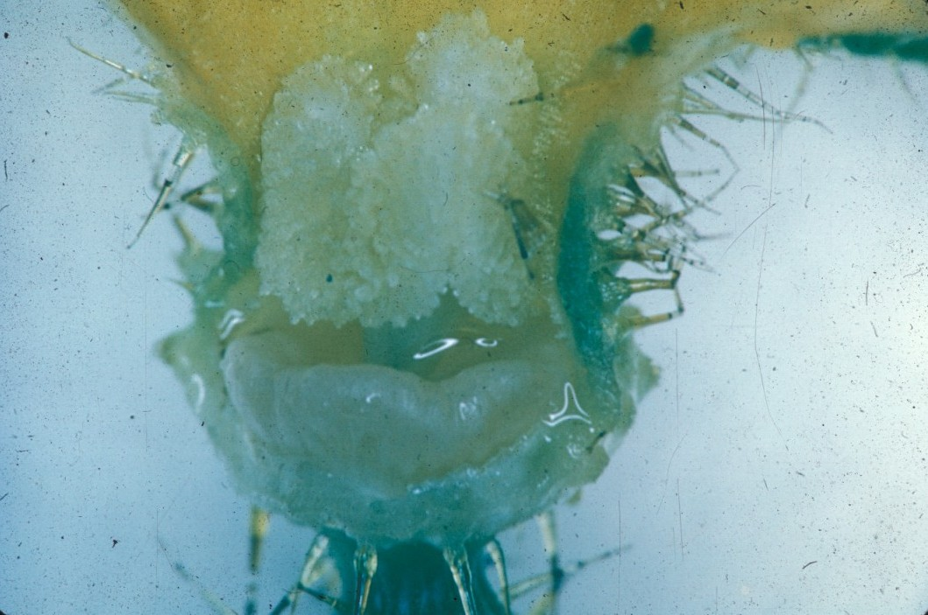
Nectar
Carbohydrate Source
“Energy Source”

Slide 6
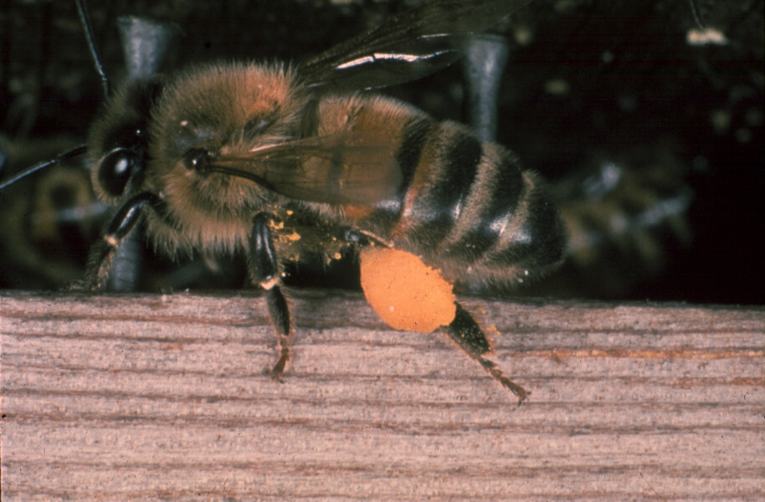
Pollen
Protein
Amino Acids
Minerals
Vitamins
Fats
Sterols

Slide 7
Protein Content Of Pollens Varies From 10-36%
Not All Pollens Are Nutritionally Alike
Bees Generally Collect And Utilize A Mixture Of Pollens
Many Individual Pollens Are Nutritionally Inadequate, Lacking In Certain Amino Acids Required By Bees

Slide 8
A Total Of 10 Amino Acids Must Be Present In The Diet Of Honey Bees For Maximum Development

Slide 9
Ten Essential Amino Acids
Threonine
Valine
Methionine
Leucine
Iso-leucine
Phenylalanine
Lysine
Histidine
Arginine
Tryptophan

Slide 10
Nectar And Pollen Not Available
Sweet-Tasting Juices From Overripe Fruit And Plant Exudates
Collect Honeydew And Store It As Honey
Rob Birdfeeders
Collect Grain From Animal Feeders

Slide 11
Extended Brood Rearing Is Not Possible Unless Pollen Or An Appropriate Source Of Protein And Vitamins Are Available

Slide 12
Honey Bees Can Live On A Pure Carbohydrate Diet For Extended Periods Of Time
Bees Are Unable To Use Pollen As An Energy Source

Slide 13
An Average Hive of Honey Bees Can Collect
100 lbs. of Pollen in a Season

Slide 14
Adult Queens Obtain Protein From Royal Jelly

Slide 15
Adult Workers (1-14 Days Old) Obtain Dietary Protein From Pollen

Slide 16
Adult Drones (1-8 Days Old) Obtain Dietary Protein From Food Supplied By Young Workers

Slide 17
If Young Workers Do Not Consume Needed Proteins
Brood Food Glands Will Not Develop Completely
Their Royal Jelly Will Not Support Normal Growth And Development Of Larvae
Will Not Support Egg Production In The Queen

Slide 18
When Nurse Bees Begin Producing Royal Jelly For Young Larvae And The Queen, They Need A Diet High In Vitamins

Slide 19
Vitellogenin Is The Main Storage Protein In Honey Bee Hemolymph
(bee blood)

Slide 20
Food Of Larval Bees Is Entirely Different From That Of Adult Bees

Slide 21
Larval Honey Bees
Worker and drone larvae receive royal jelly for first two days, then worker and drone jelly + (bee bread)
Queen larvae receive royal jelly throughout their larval period

Slide 22
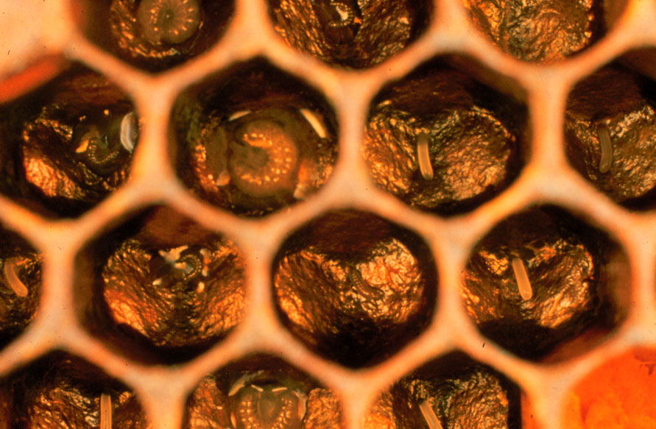

Slide 23
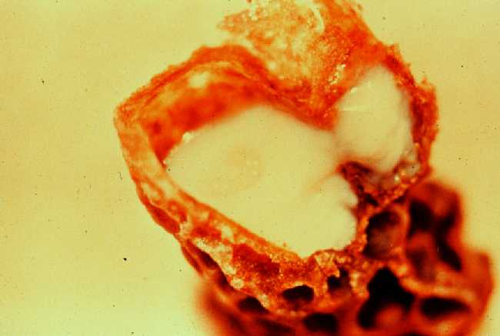

Slide 24
Pollen Is Essential For The Growth Of Emerging Young Bees And For The Development Of The Brood Food Glands

Slide 25
Anytime Less Than Three Full Frames Of Honey, The Colony Should Be Fed
Do Not Feed Brown Sugar Or Molasses

Slide 26
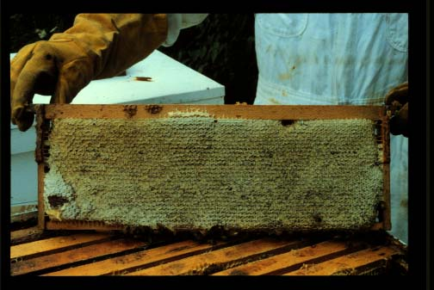

Slide 27
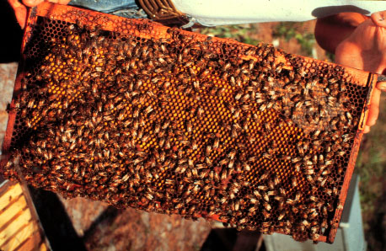

Slide 28
Pollen Supplement
Pollen Substitute

Slide 29
1 Pollen Cake
2 oz. Pollen
5.5 oz. Water
10.5 oz. Sugar
6 oz. Soybean Flour

Slide 30
32 Pollen Cakes
4 lbs. Pollen
11 lbs. Water
21 lbs. Sugar
12 lbs. Soybean Flour

Slide 31
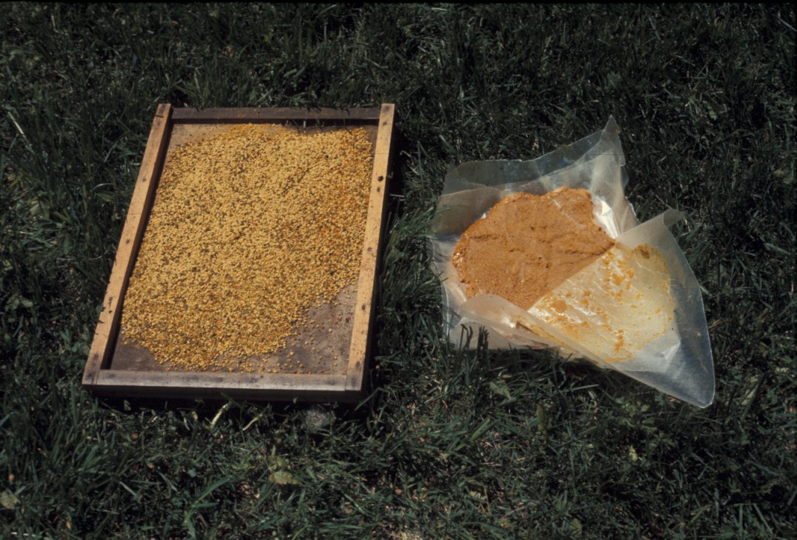

Slide 32
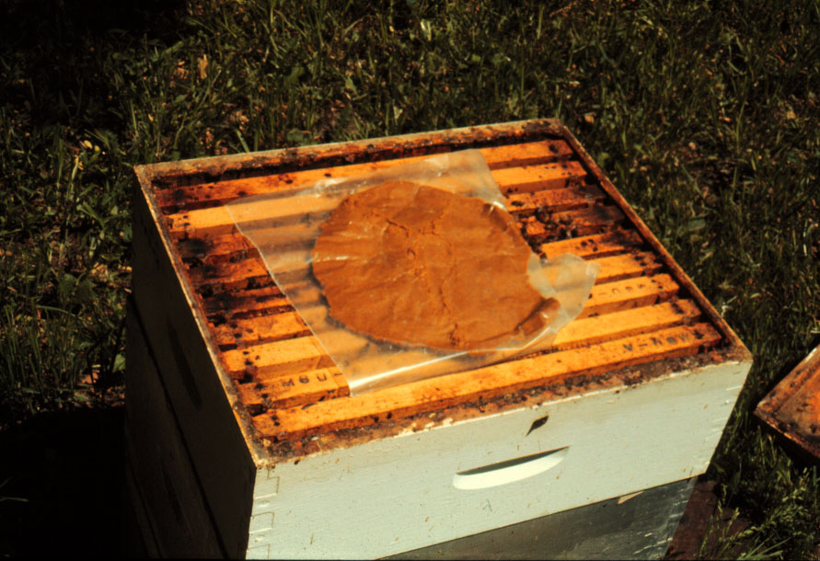

Slide 33
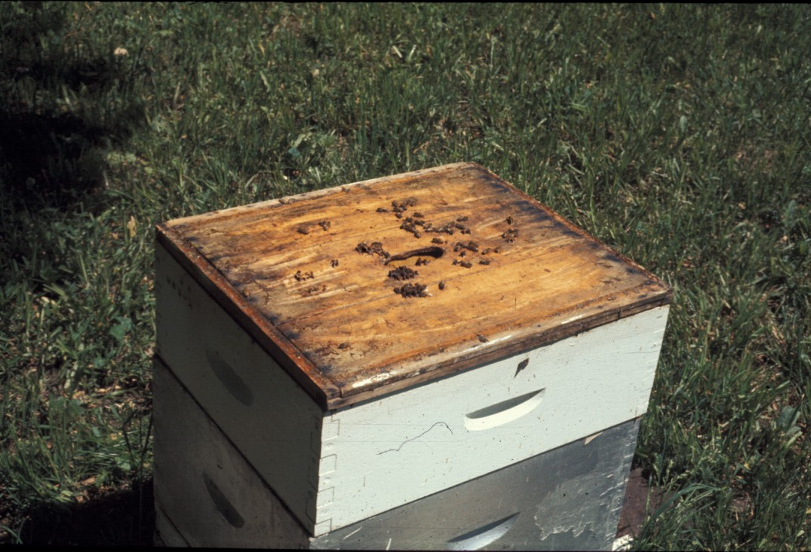

Slide 34
Pollen Substitutes
Bee Pro® Is A Soy Meal Based Diet
Feed Bee® Is A Non-Soy Based Diet
MegaBee™ The Tucson Bee Diet

Slide 35
MegaBee™ May Be Used As A Liquid, Patty Or As Dry Feed

Slide 36
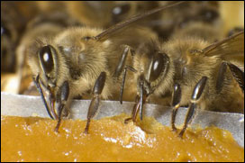
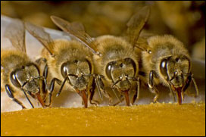
MegaBee™

Slide 37
MegaBee™
Tripled Brood Production And Increased Adult Population By 30% Over Controls
In stock now at:
Bluebonnet Beekeeping Supplies!

Slide 38
Whats Blooming?
Wild Onions
Almond Verbena
Mist Flower
Grancy Graybeard
Abelia
Ragweed
Goldenrod
Texas Sage

Slide 39
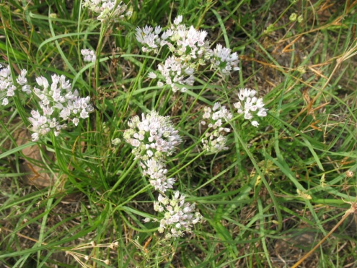
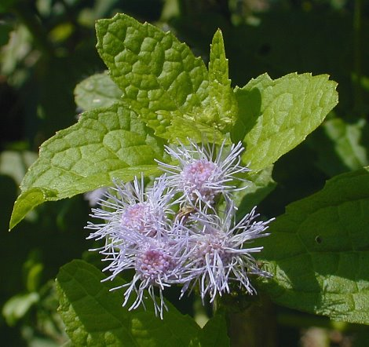
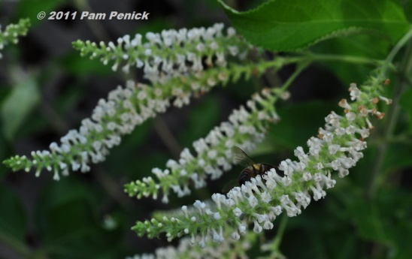
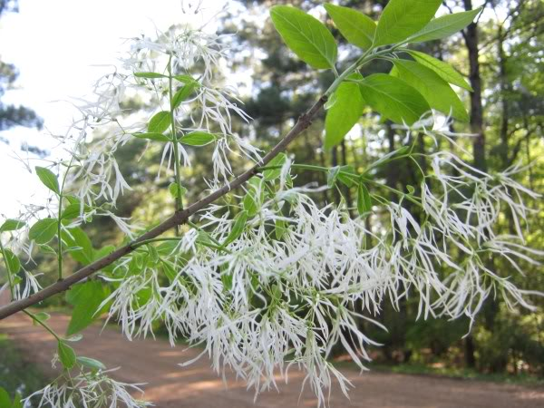
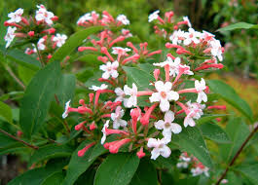
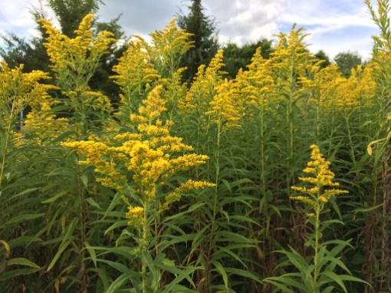
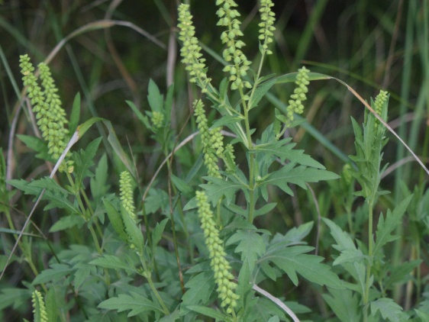
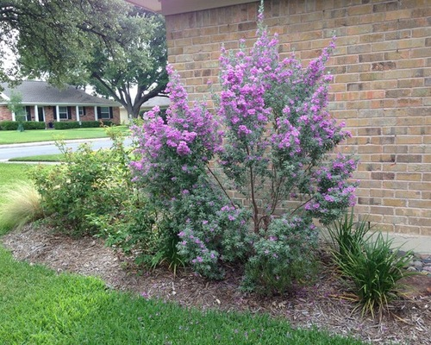

Slide 40
Any Questions

