Slide 1
Honey, Water, & Chemistry
– June 2017 –
Micky Cross
Co-First Vice President

Slide 2
Overview
Fermentation
Percentage of Water In Your Honey
Crystallization
You Should Check Your Honey’s Moisture Content

Slide 3
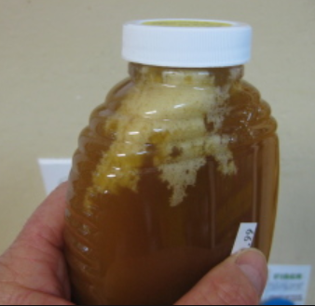
Doesn’t Honey Last Forever?
It Depends
Will Not Spoil In Traditional Sense, But Can Begin to Ferment
All Honey Has A Few to A Lot of Yeast Spores
Yeast Spores Activate When There Is Enough Water To Sustain Them
Honey Will Not Ferment Below 50 Degrees and Above 80 Degrees
To Be Consider USDA Grade A, Honey Must Be 18.6% Water or Less
Bottom Line: You Need To Know Your Honey’s Moisture Content
Honey with less than 17.1 percent water will not ferment in less than a year, irrespective of the yeast count.
Between 17.1 and 18.6 percent moisture, honey with 1000 yeast spores or less per gram will be safe for at least a year.
When moisture is between 18.6 and 19 percent, not more than 10 yeast spores per gram can be present for safe storage.
Above 19 percent water, honey can be expected to ferment even with only one spore per gram of honey

Slide 4
Don’t The Bees Only Cap When Ready?
Well, They Try ☺
Nectar
~80% Water
Most of the Rest is Sucrose (Table Sugar) (A Complex Sugar)
Honey
< 18.6% Water
Main Sugars Are Glucose And Fructose (Simple Sugars)
The Sugars Are Supersaturated In The Water
Bees (Via Enzymes and Actions):
Break Down The Sugars
Remove Water
Facility Supersaturation (Without a Stove Top!)
Cap The Honey When Moisture Content is ~ 15% to 19%

Slide 5
So If It’s All Capped, I’m Good, Right?
Traditional Rule Of Thumb
Only Extract From Frames At Least 75% Capped
Reasonable In Many Geographic Locations
Montgomery County – Not So Much. ☹
We Live In A Hot, Humid Area
Bees Struggle To Get Moisture Content Down
Capped Honey Is Probably Near The Upper Limit Of What They Will Accept
And, The Uncapped Cells Are Likely Higher
Honey is Hydroscopic
Absorbs Water Easily
Extraction And/Or Exposure To Air When Relative Humidly Above 60%
Honey Is Pulling In More Water
You Can Start Below 18.6% and End Above

Slide 6
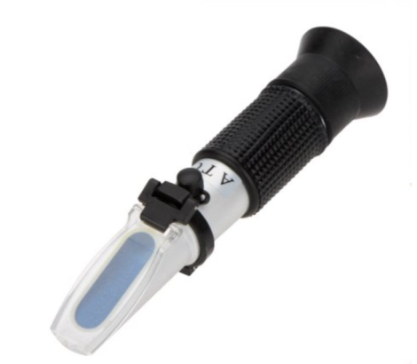
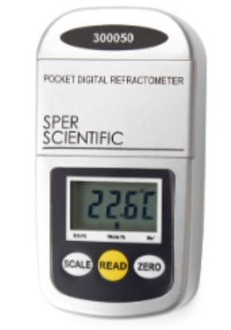
So How Do I Know The Water Content?
Measure Samples of Your Honey With A Refractometer
Available For Many Uses
Wineries, Brewers, Fruit Juice, Beekeepers, Etc.
Get One For Honey Moisture Content
Will Have A Direct Scale for % Water
Others May Only Show “Brix”, Specific Gravity, or “Baume”
Conversion Required
Measurement Changes With Temperature
Some Have Automatic Temperature Control (ATC)
Otherwise, Adjust Numerically According to Instructions
Most based on 68F – 20C

Slide 7
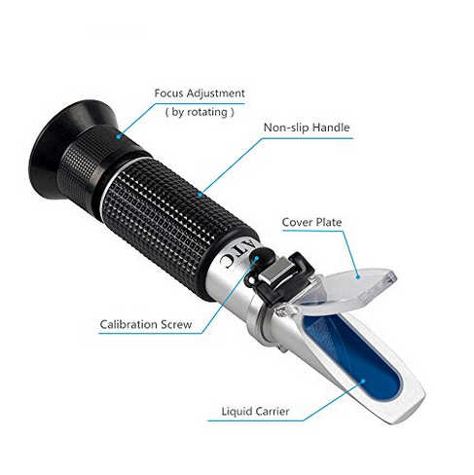
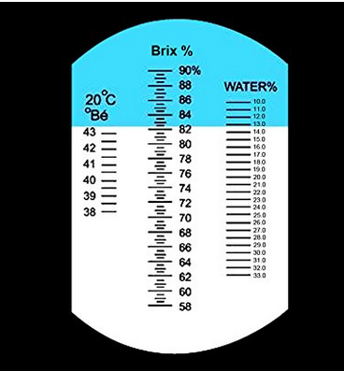
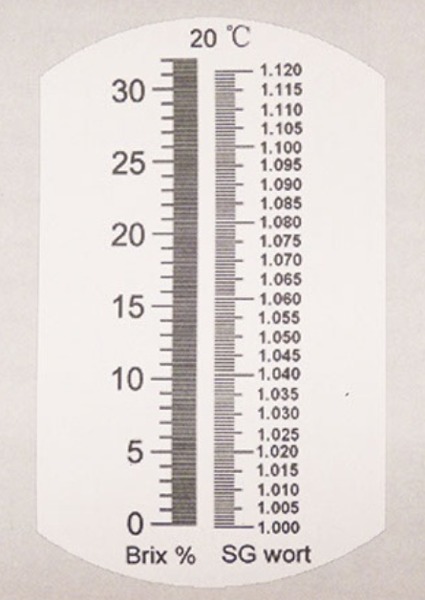
Using A Refractometer

Slide 8
Using A Refractometer
Calibration
May Come With Calibration Liquid
Follow Directions
Many Use Extra Virgin Olive Oil
71.5% on Brix Scale
Distilled Water Can Also Be A Calibration Source
Refractometer must allow Brix of 0 Reading – Many Will Not
Clean Surface With Lent Free Cloth After Each Use
Demonstration
If No ATC, Must Numerically Adjust For Temperature (Follow Instructions)

Slide 9
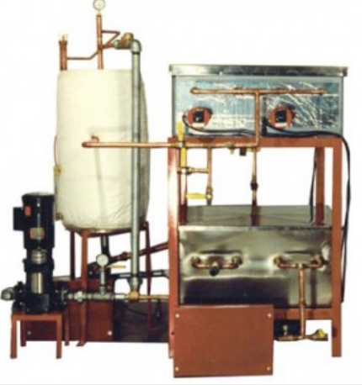
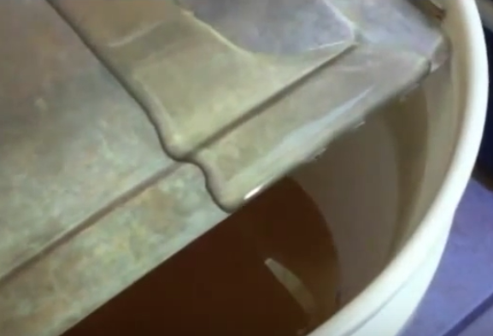
It Is Too High, Now What?
Many Methods / Ideas Available On the Internet
Dehumidifiers
Fans
Small Rooms
Surface Area
Stirring
We Put Bucket in Electronic Closet With Filter Mesh On Top and Fan Blowing Across The Top & Stirred Several Times A Day
Went From 20% to 18% in ~ 8 Days
Be Mindful of Small Hive Beetles and Wax Moths

Slide 10
Crystallization
It’s Good Thing
All Raw, Natural, Unfiltered Honey Will Crystallize
How Quickly Depends On Percent of Glucose
Higher Saturation Point, Starts on Solid Surfaces (Pollen, Wax, Propolis, etc.)
Fine Filtering and High Heat To Melt Impurities Will Prevent
Glucose Is Sweeter Than Fructose – Crystals Sweeter Than Remaining
It’s A Bad Thing
If You Are On the Edge of Water Content Percentage
As Glucose Crystallizes and Becomes Solid, Percentage of Water In Remaining Honey Goes Up
Once Crystallization Starts, Monitor Closely For Fermentation

Slide 11
Conclusion
Check Your Moisture Content
Before Extraction If Reasonable
But At Least After Extraction
Do Not Sell Honey With Too High Of Moisture Content
Best To Also Not Give It Away, But If You Do Make Sure They Know The Risks and Signs of Fermentation
Use Within Three Months
Store Below 50 Degrees
Be Mindful of Fermentation Once Honey Begins Crystalizing

Slide 12
QUESTIONS

